Slide 1
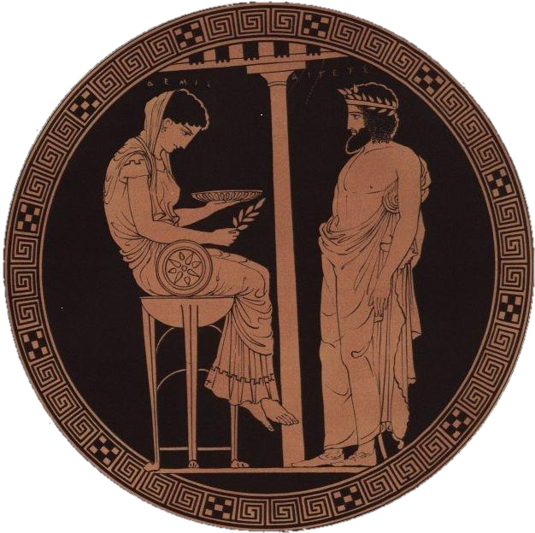
Open Modeling Framework
By David.Pinney@NRECA.coop
Last update 21 June 2017

Slide 2
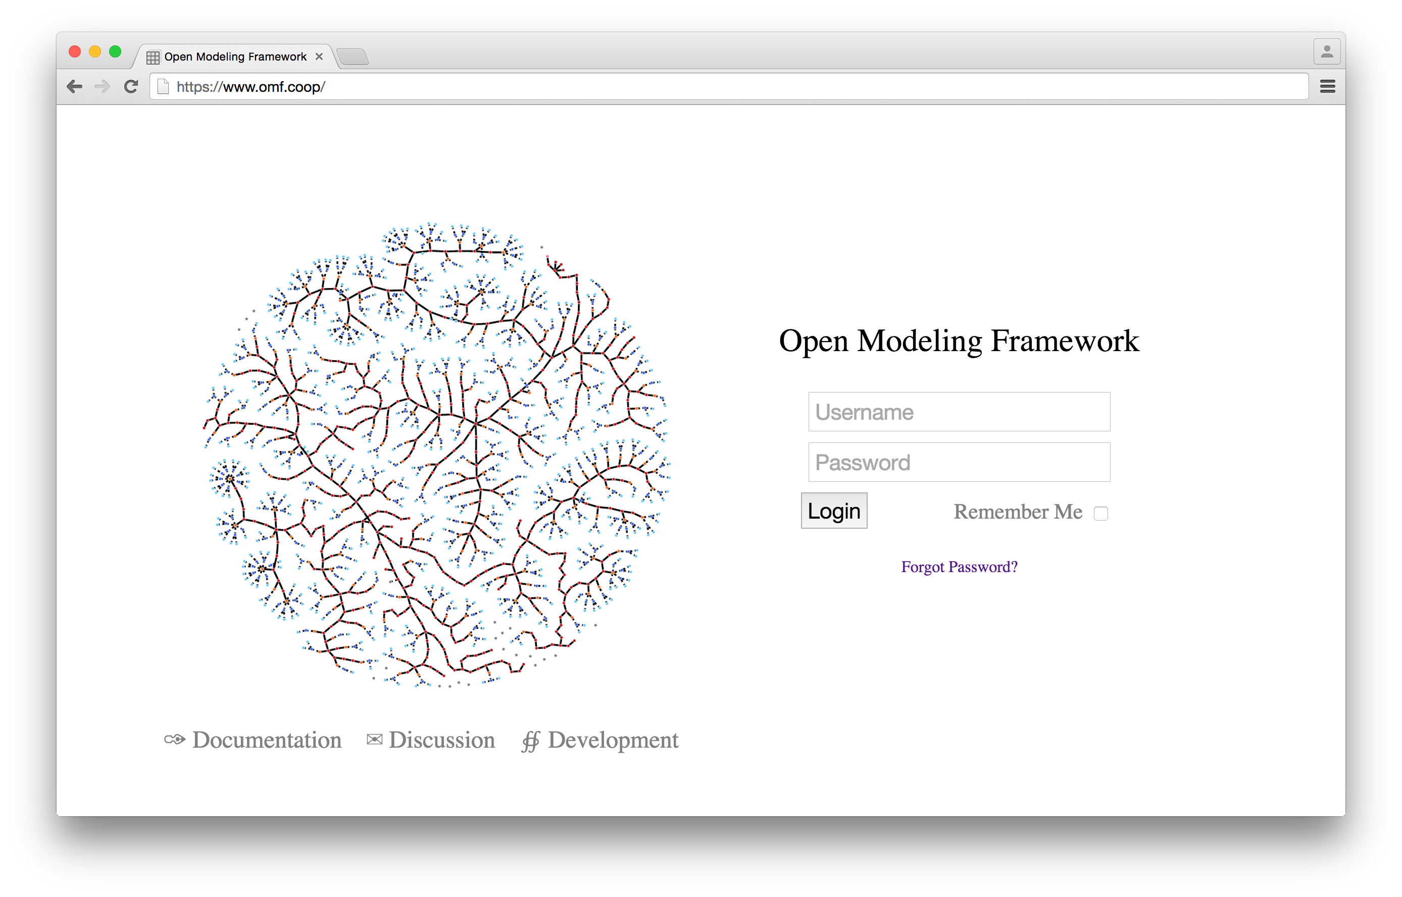
The OMF is a website, https://www.omf.coop/...

Slide 3
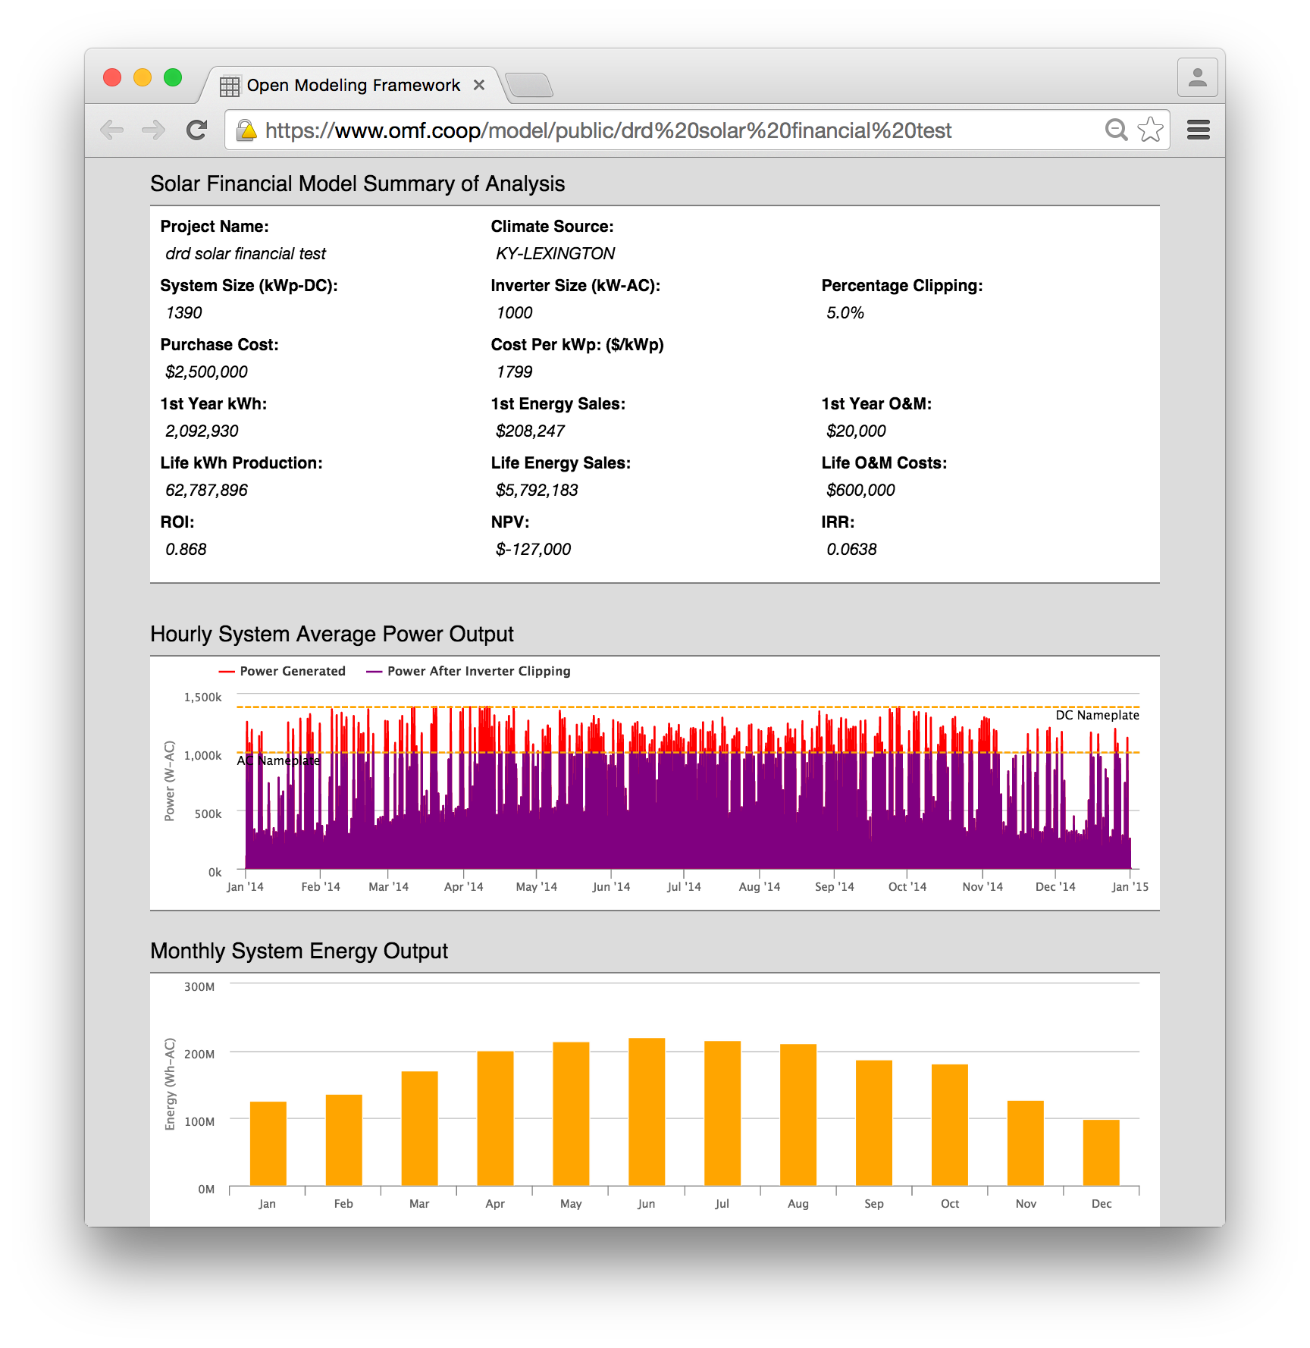
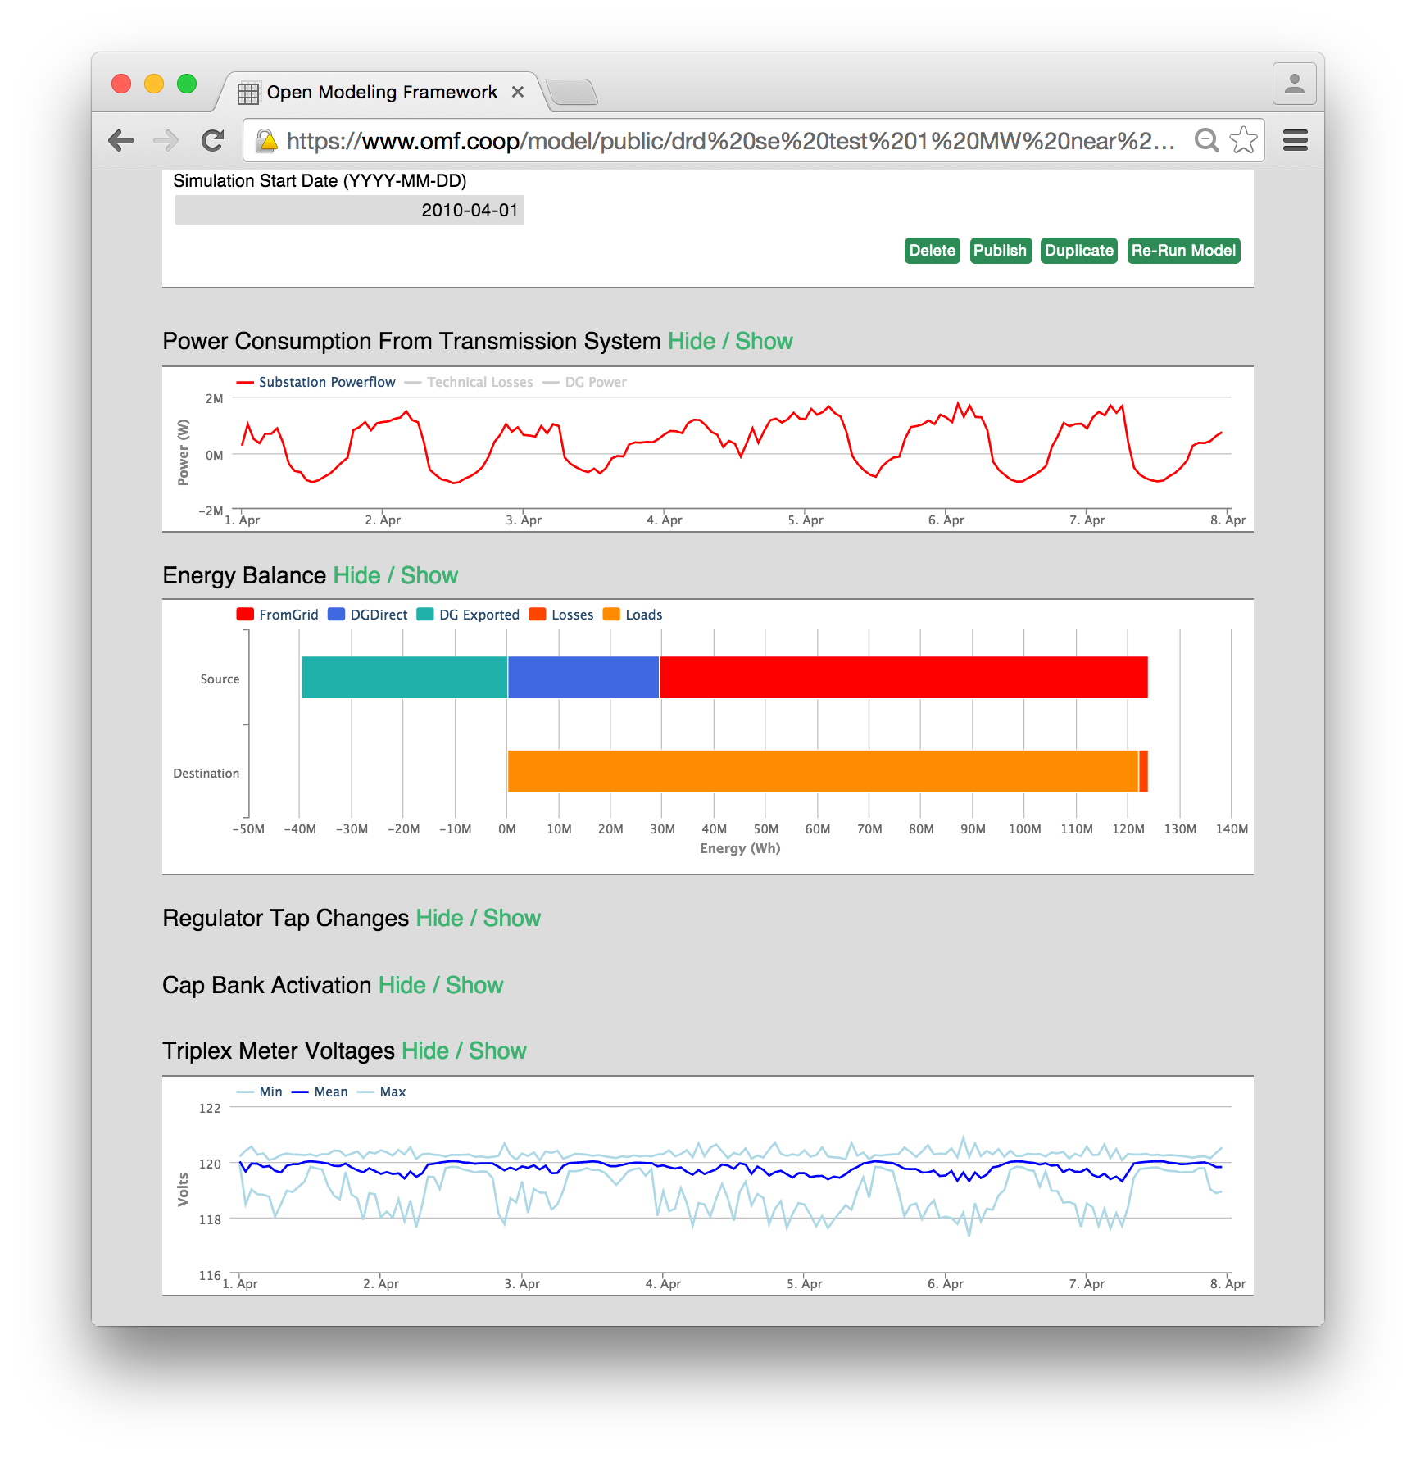
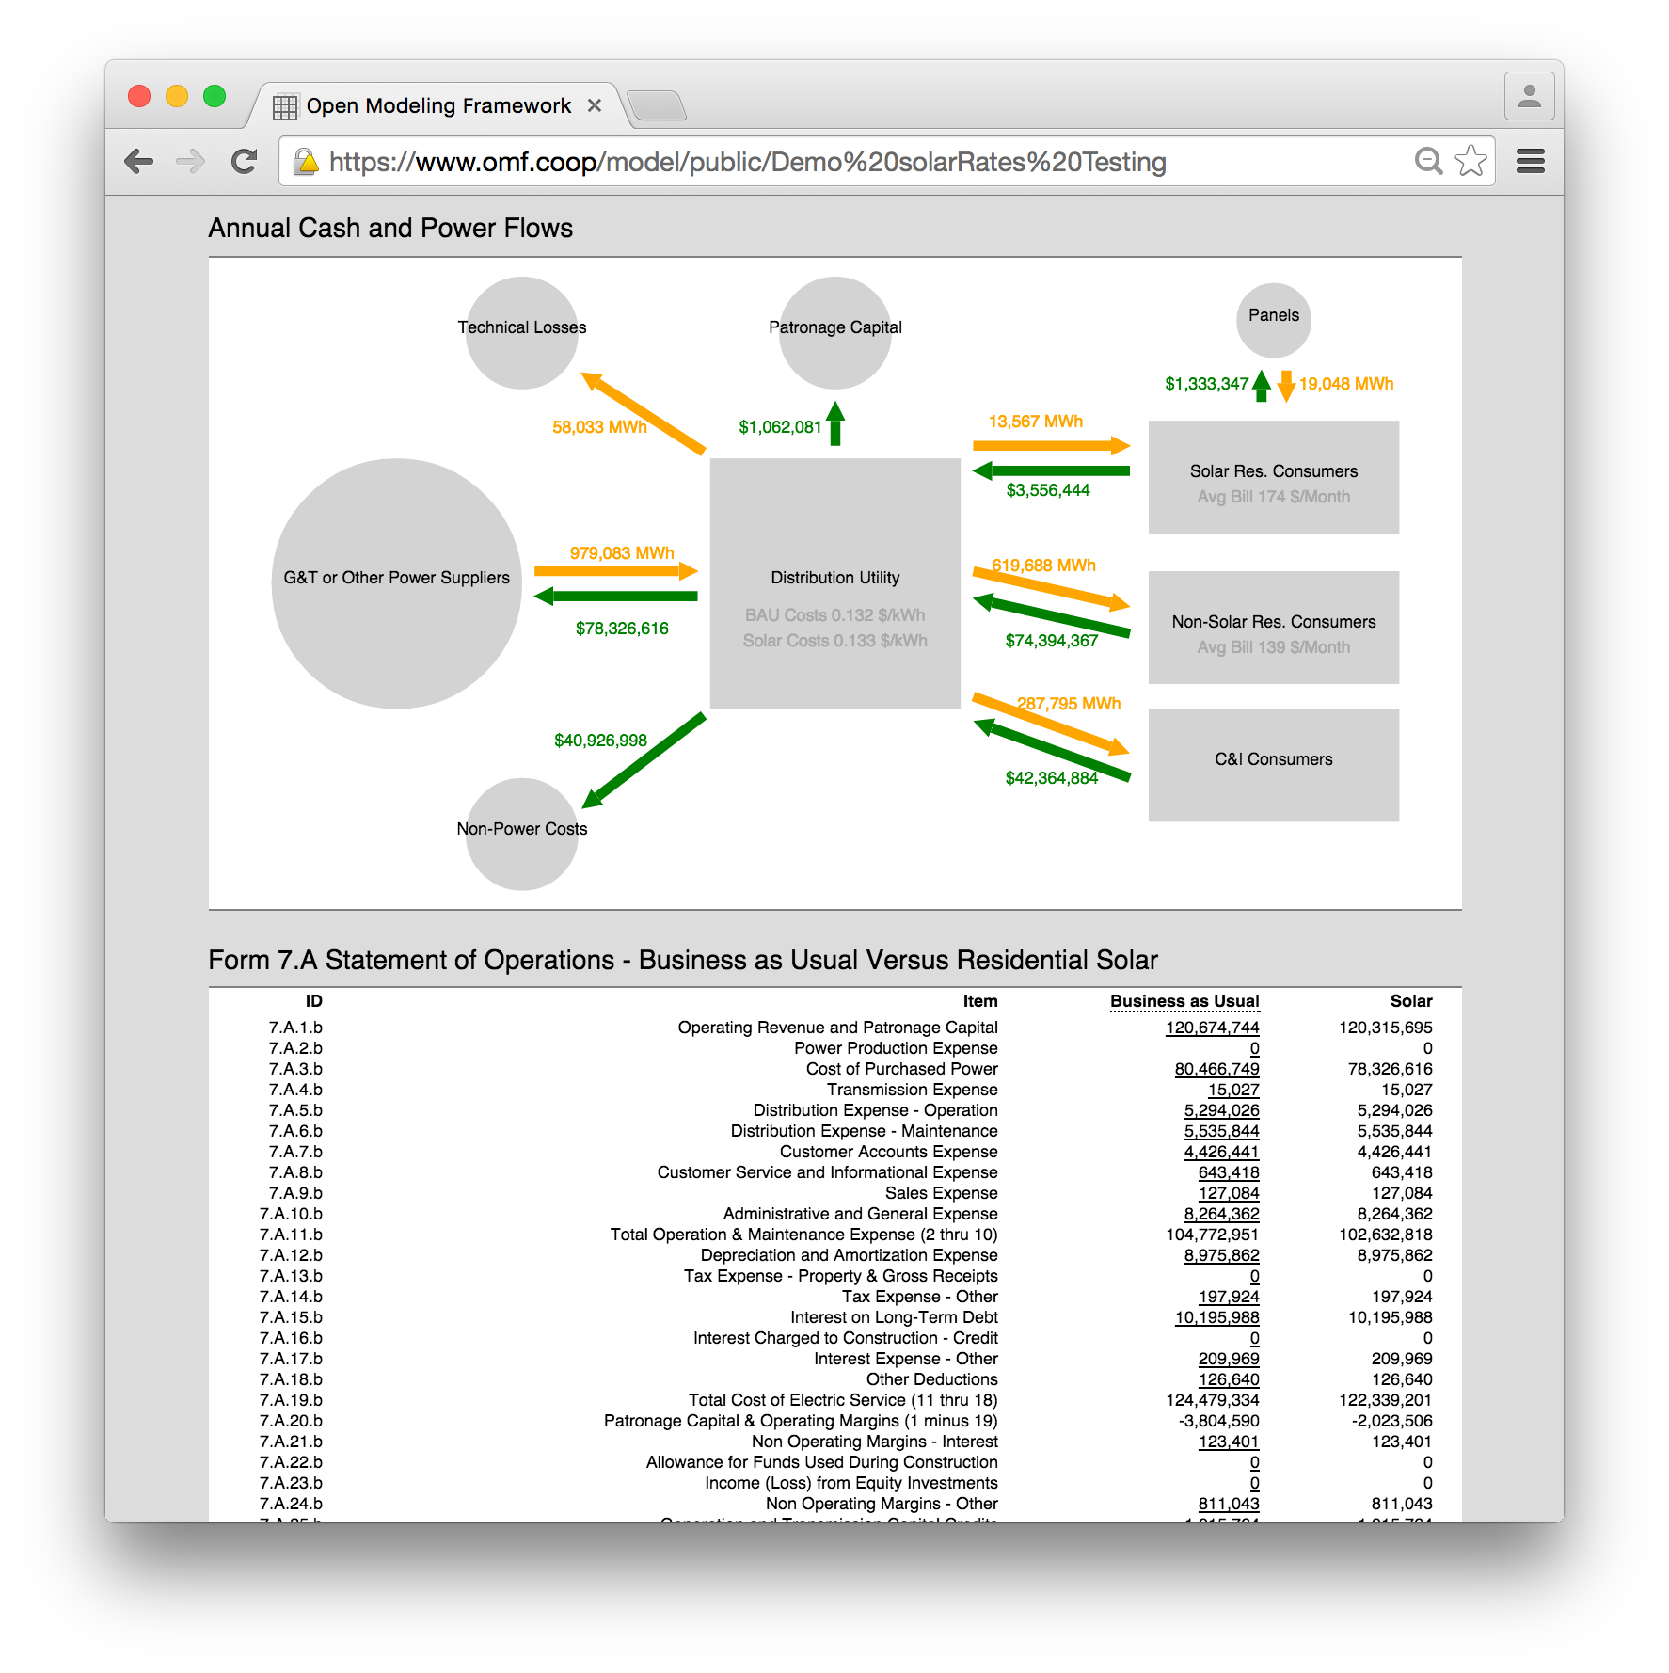
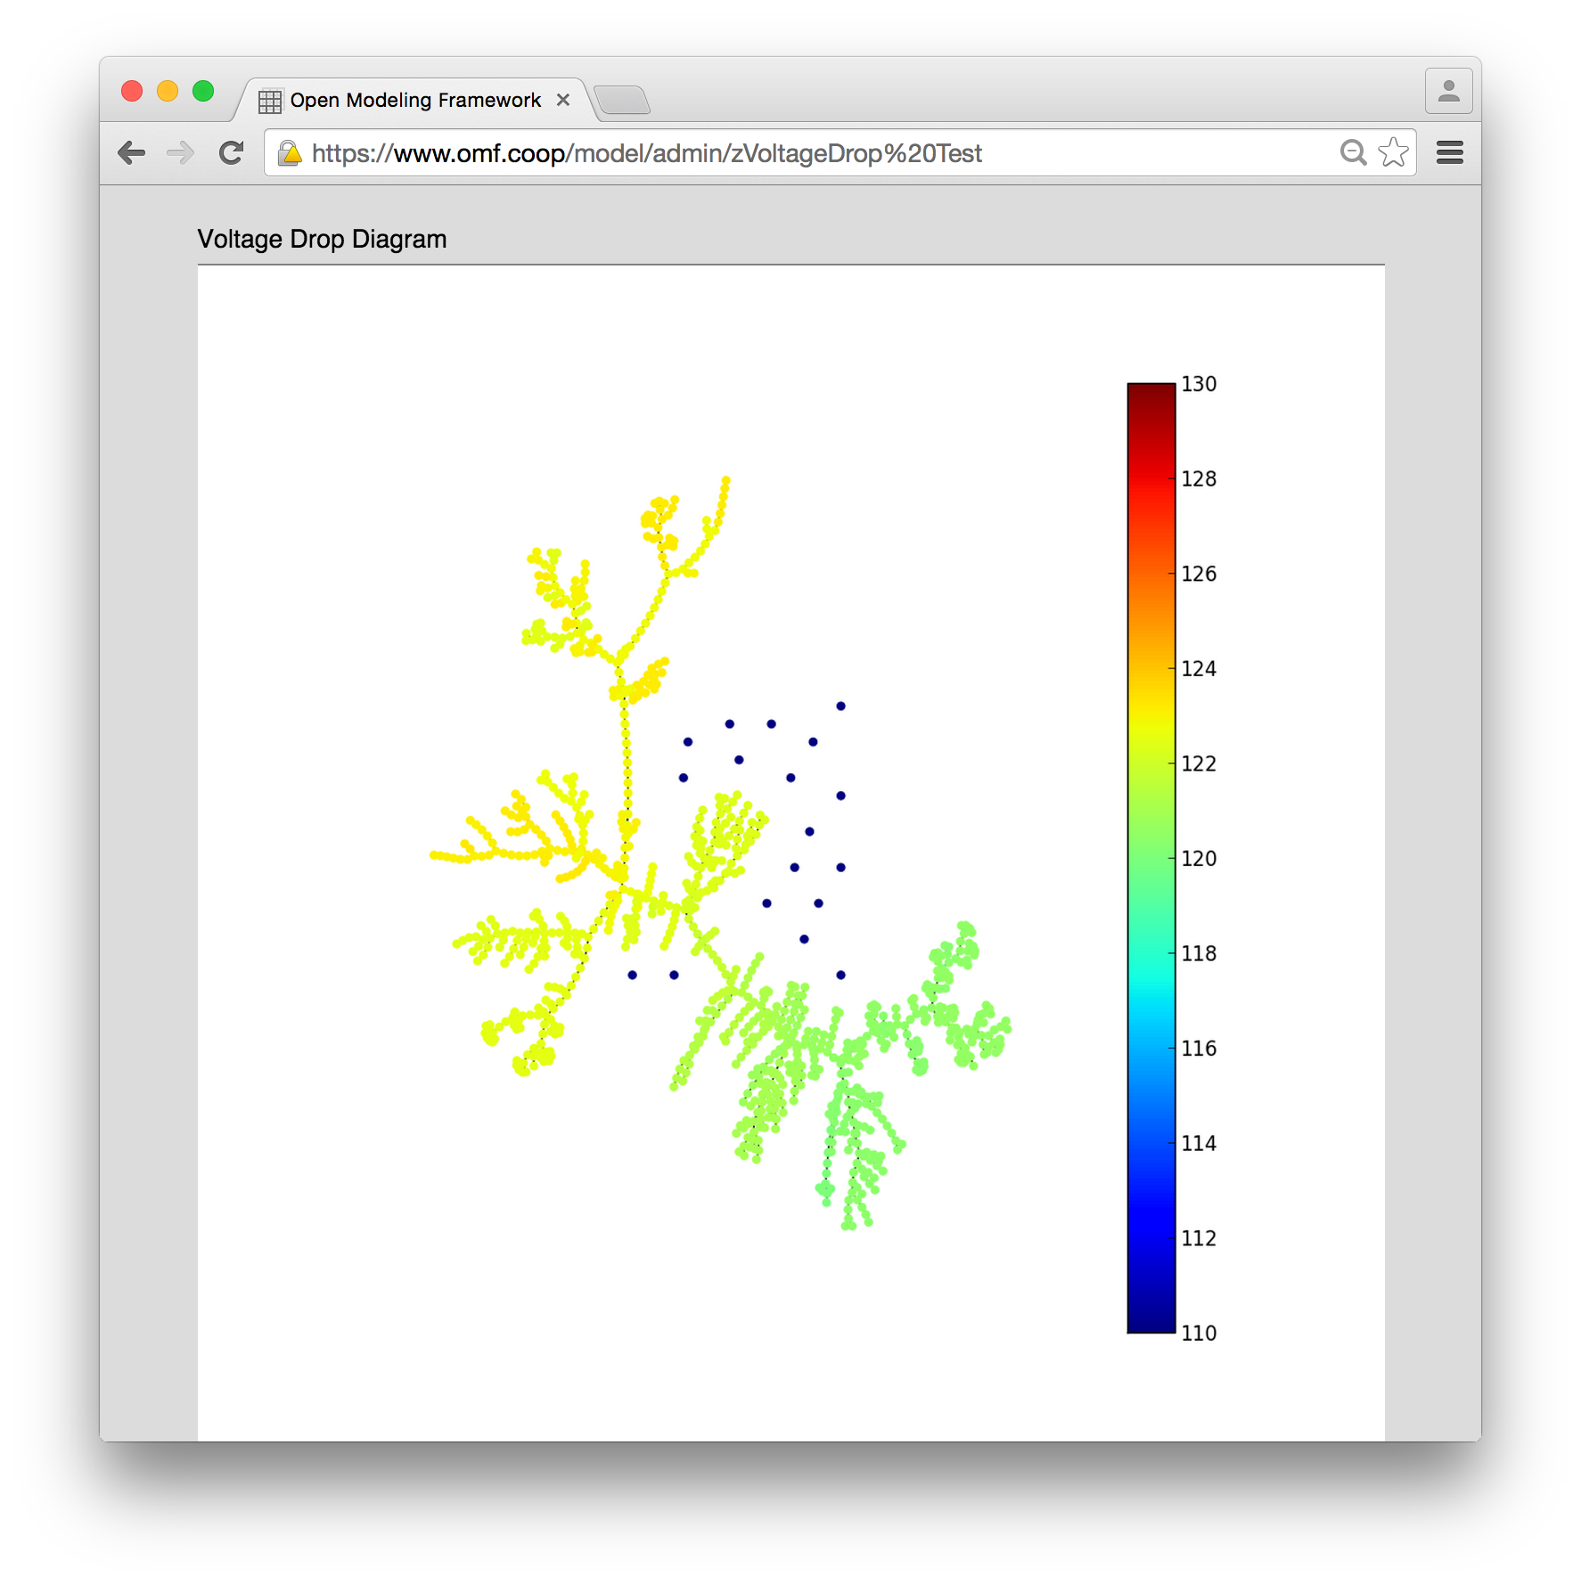
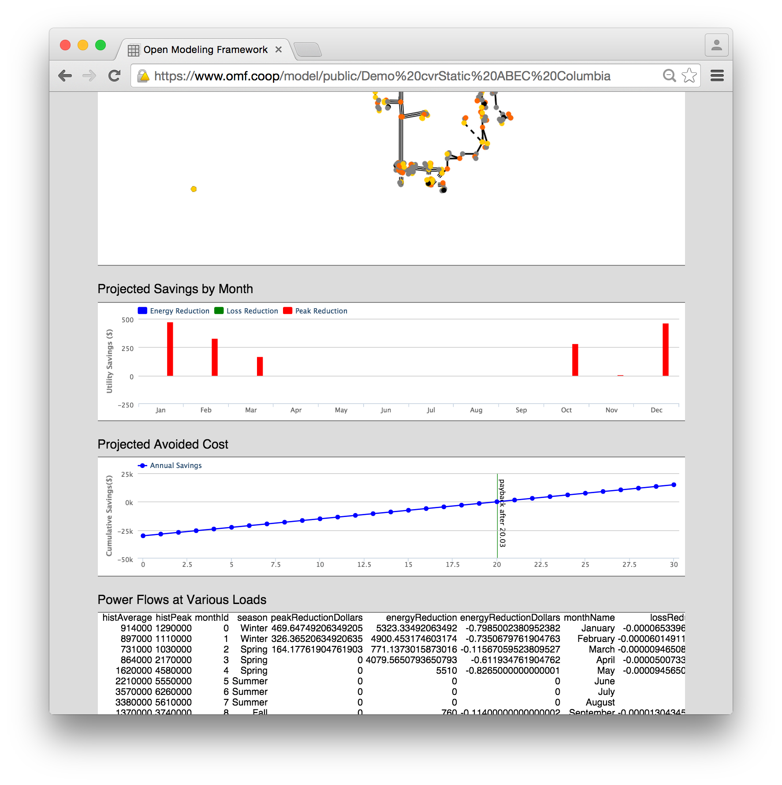
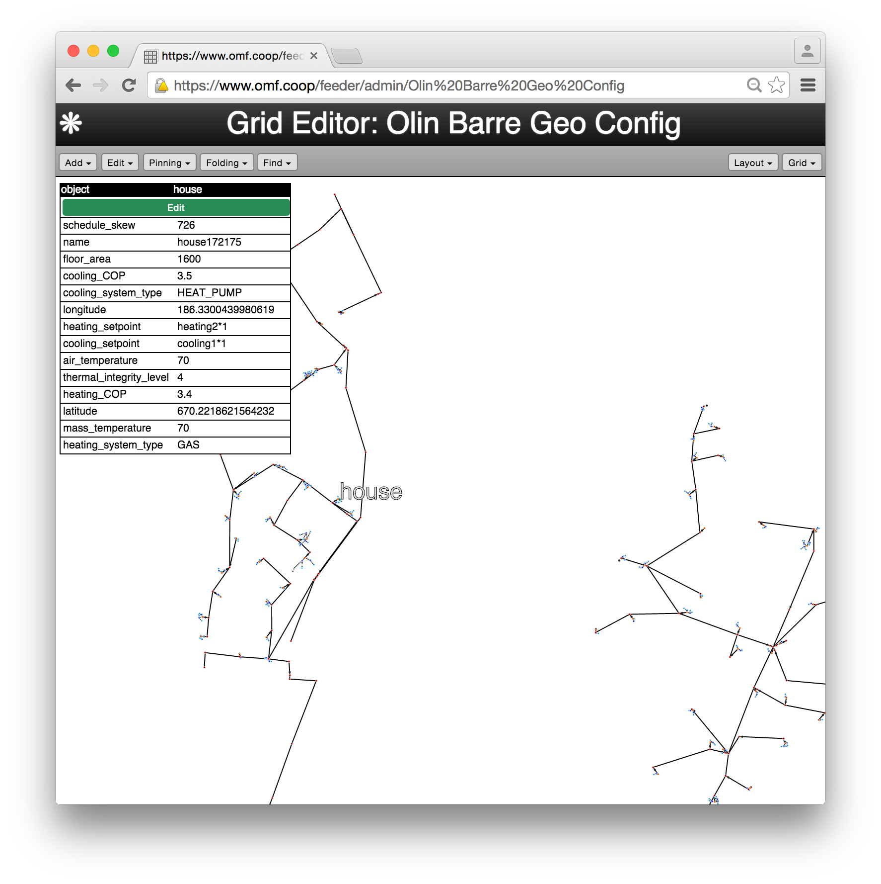
… that gives you access to models…

Slide 4
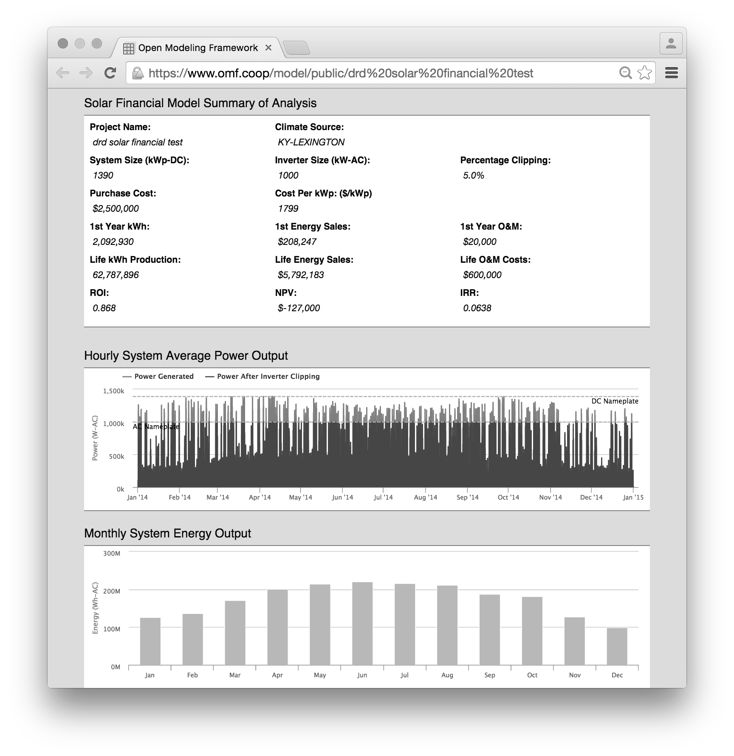
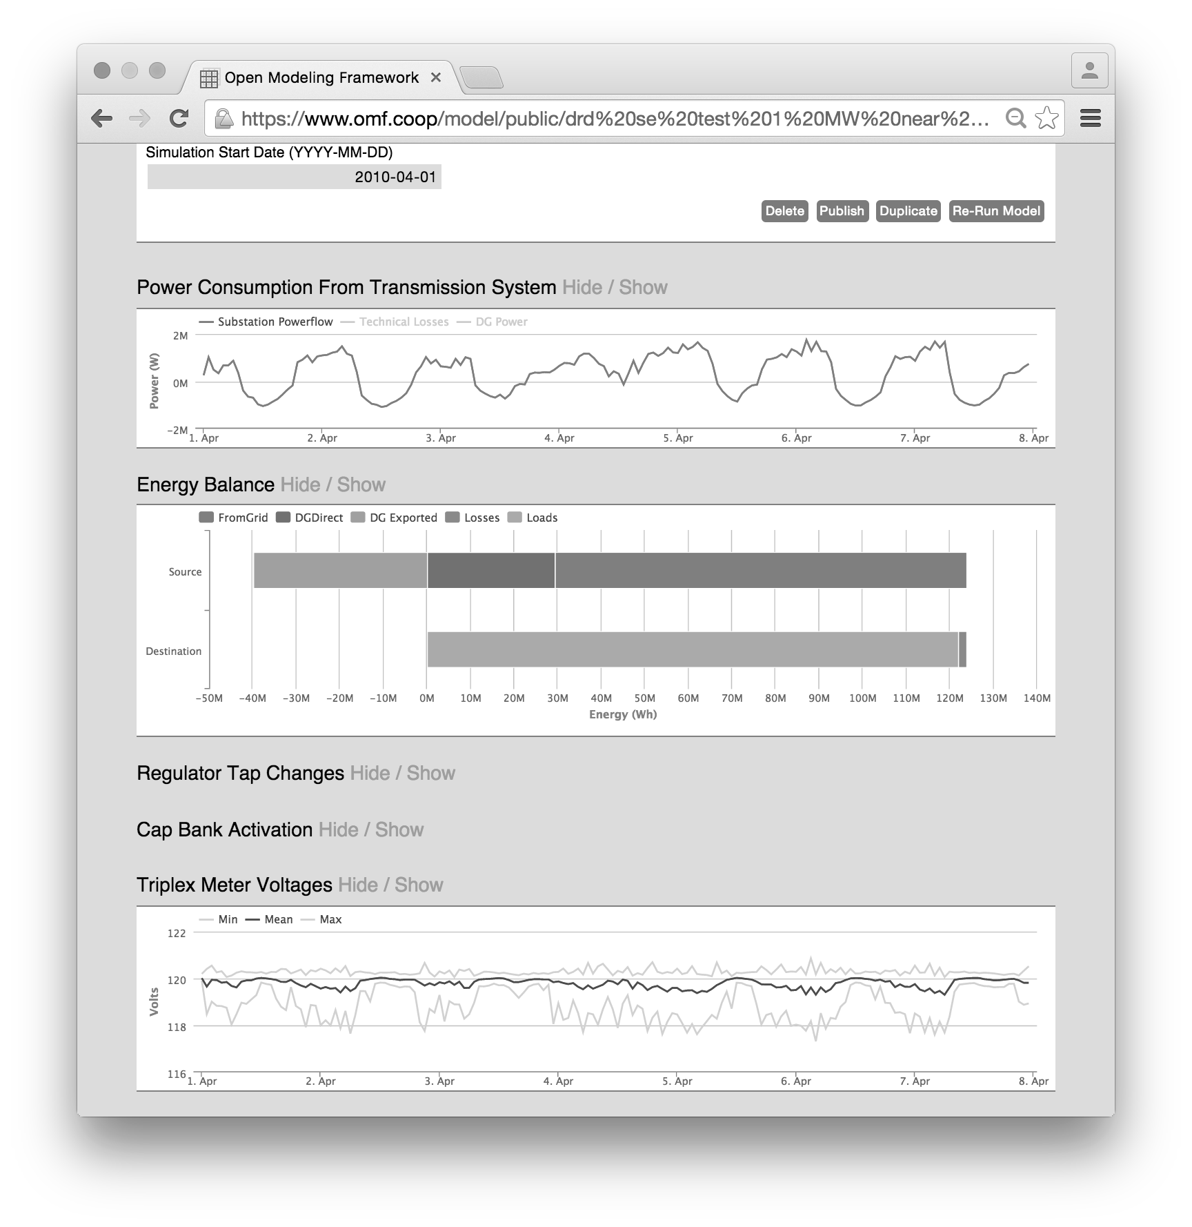
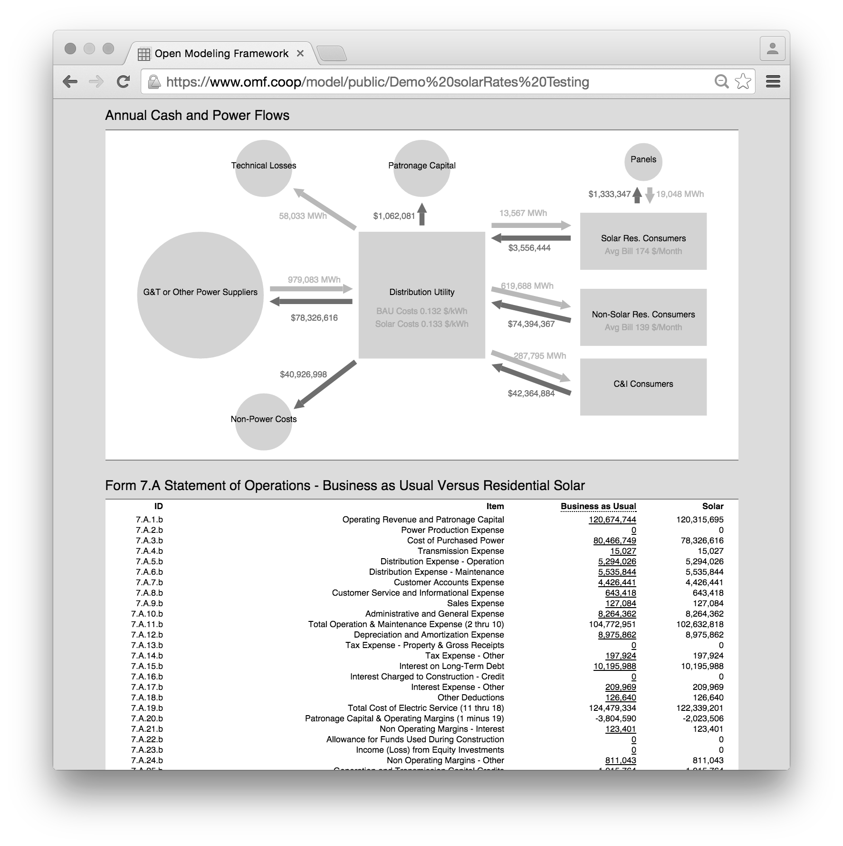
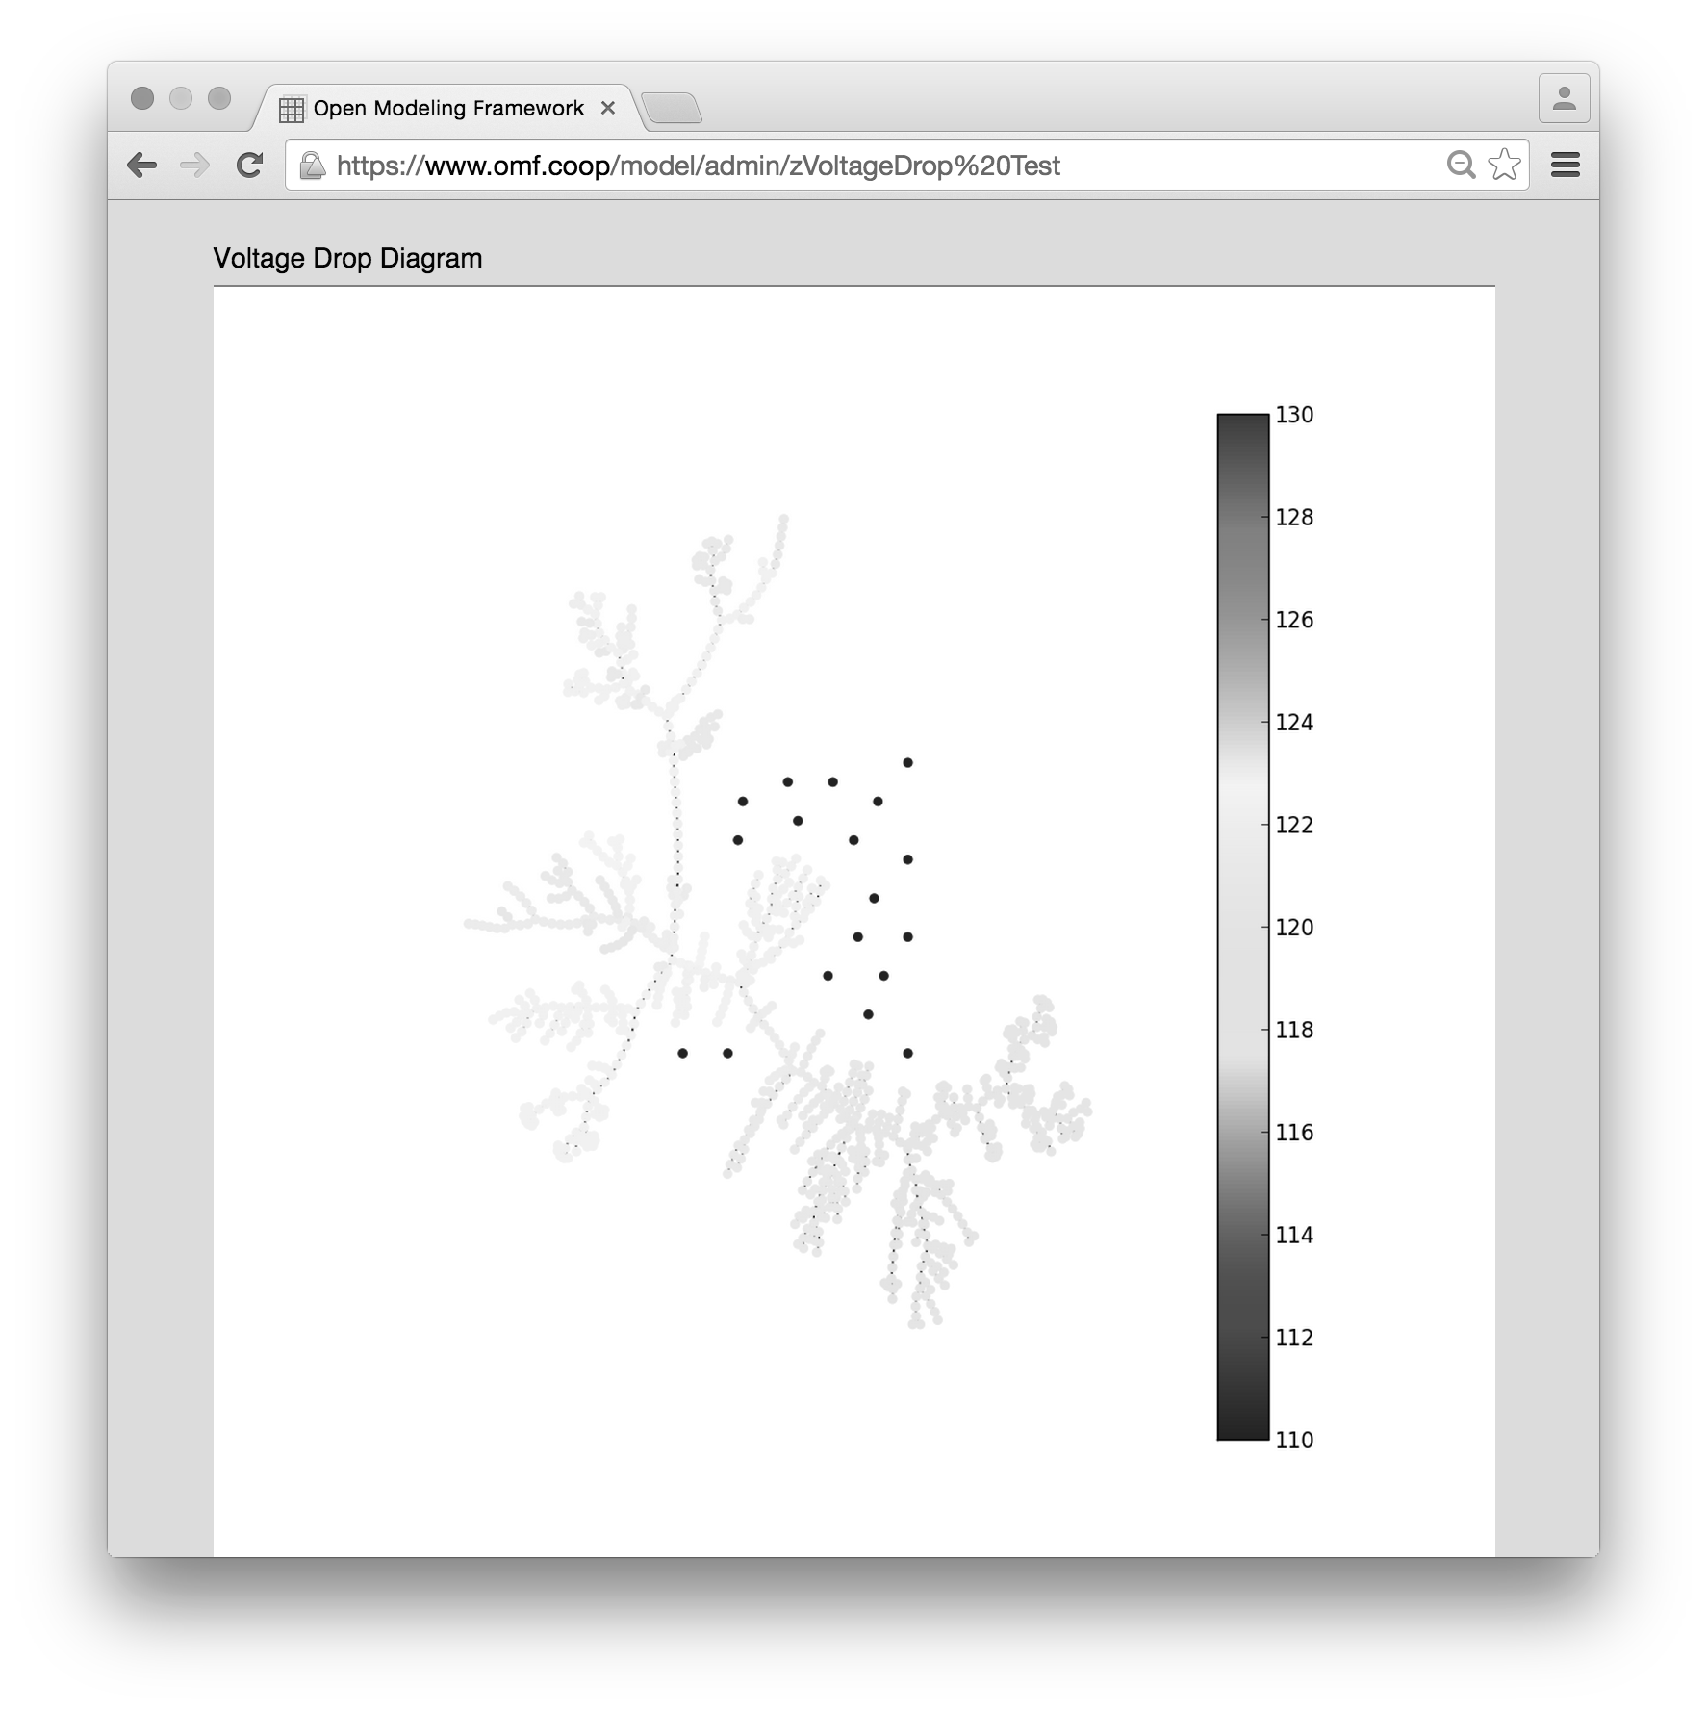
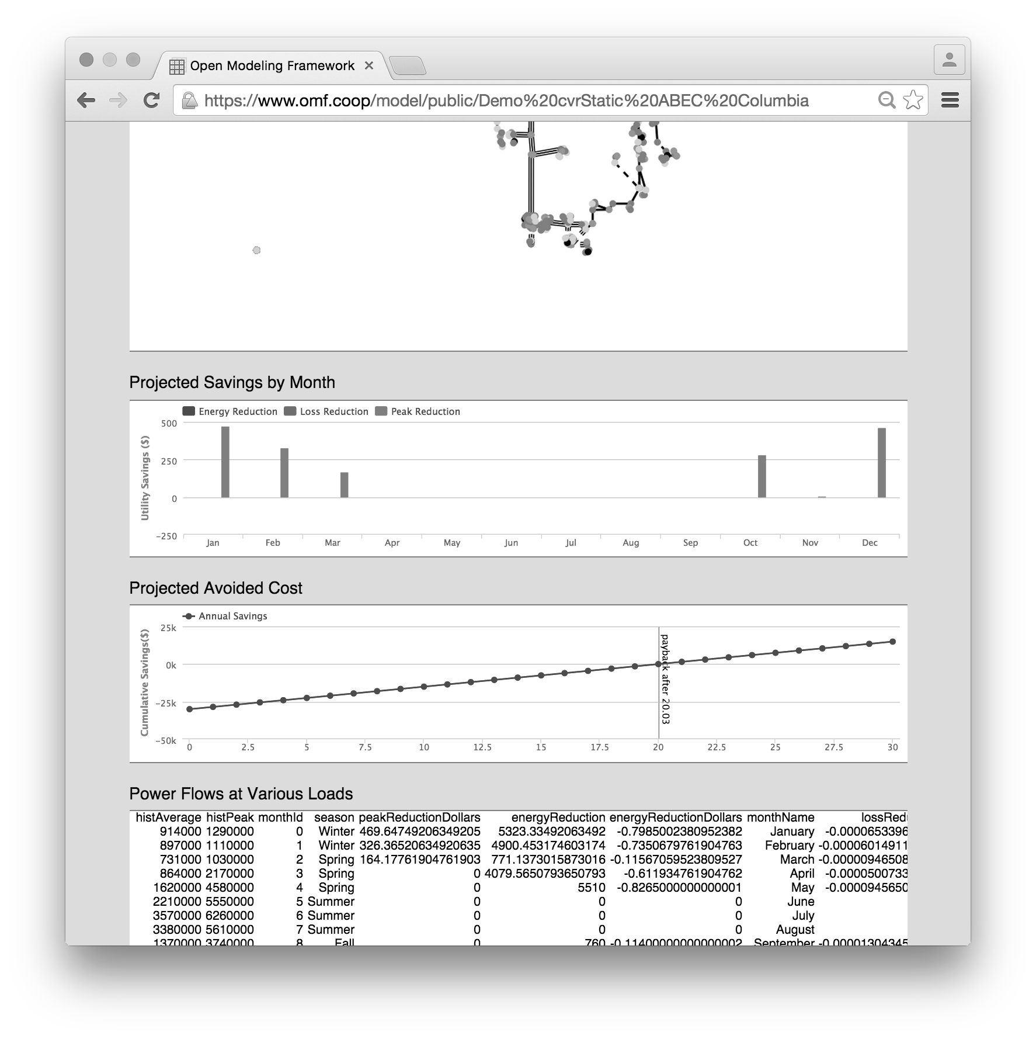
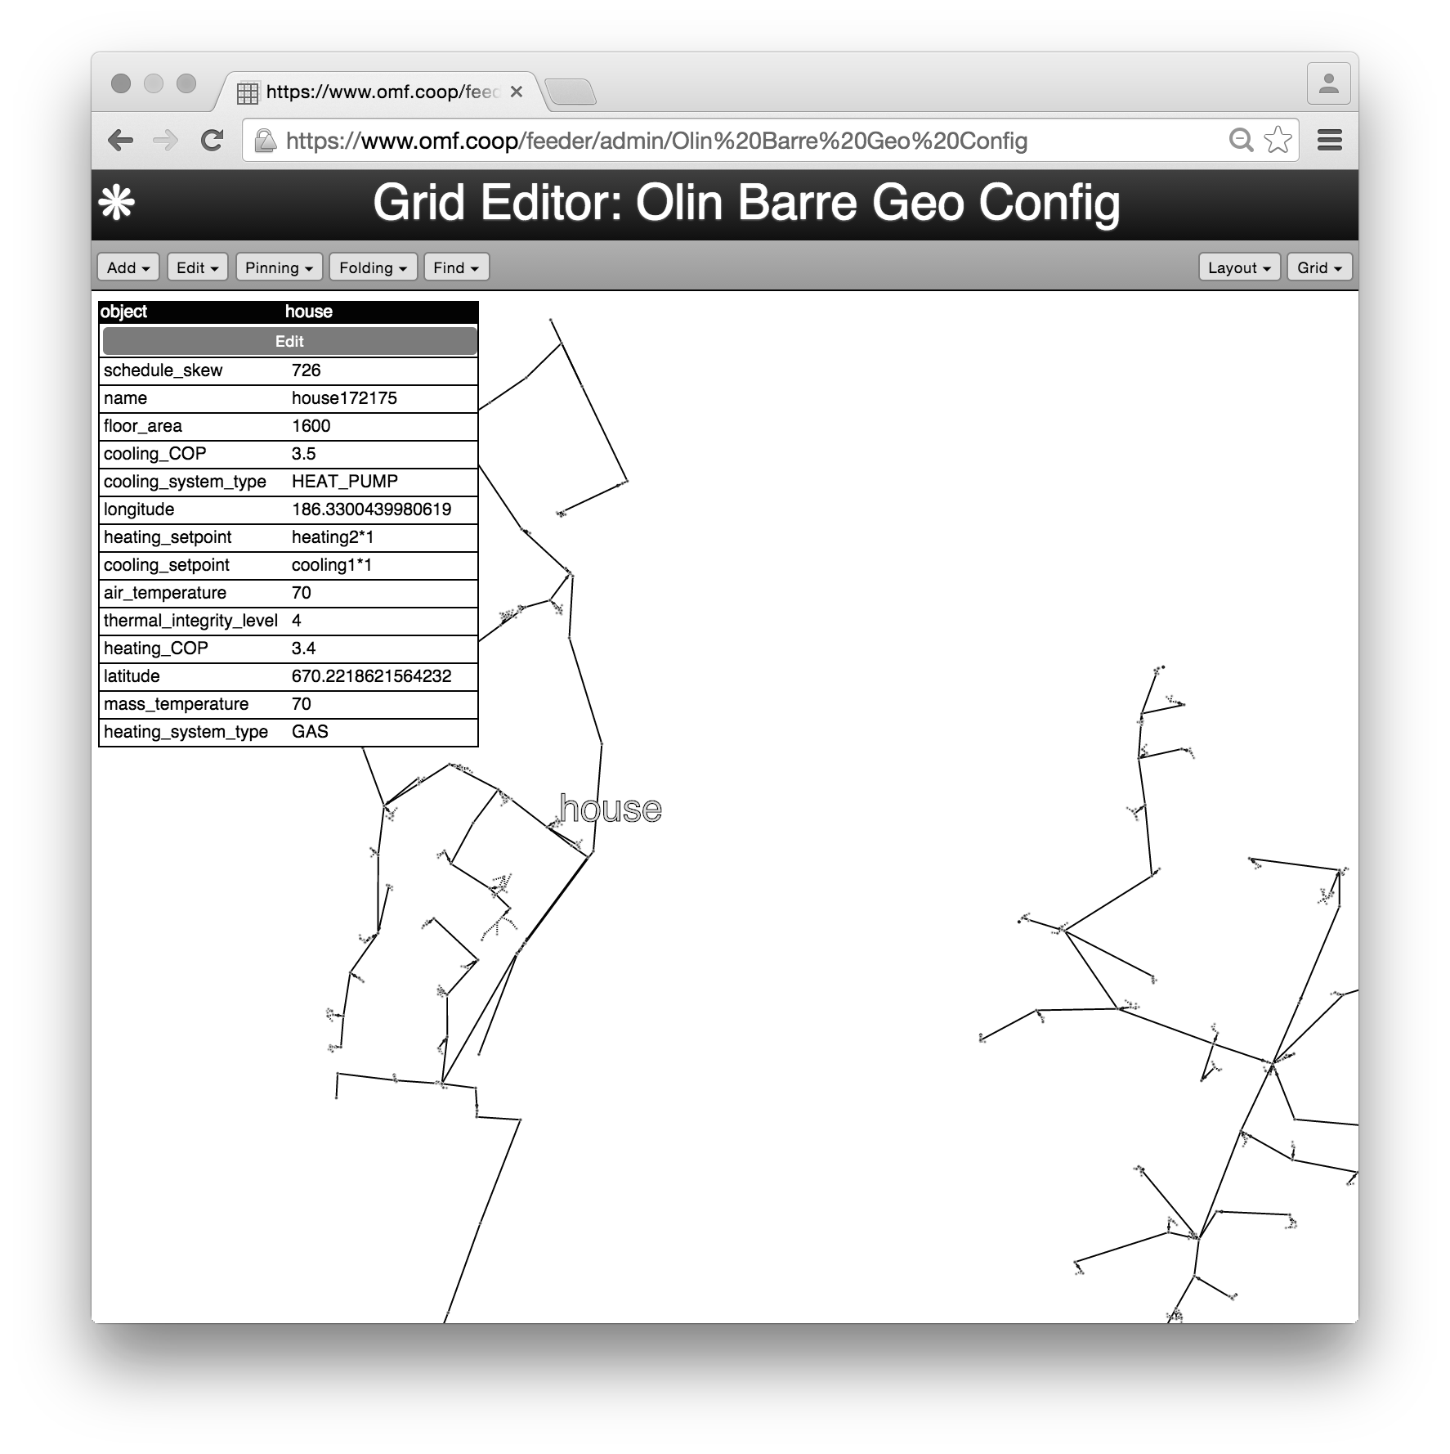
… models that help electric utilities answer distribution planning questions.
solarEngineering: how big are the voltage and reverse power flow effects of distribution-connected solar?
solarFinancial: how much does utility-owned solar cost?
solarRates: how does rooftop solar impact utility and consumer costs?
voltageDrop: will a new load push voltages outside of legal limits?
cvrStatic: does conservation voltage reduction pay off for a given feeder?
gridlabMulti: simulate everything…?

Slide 5
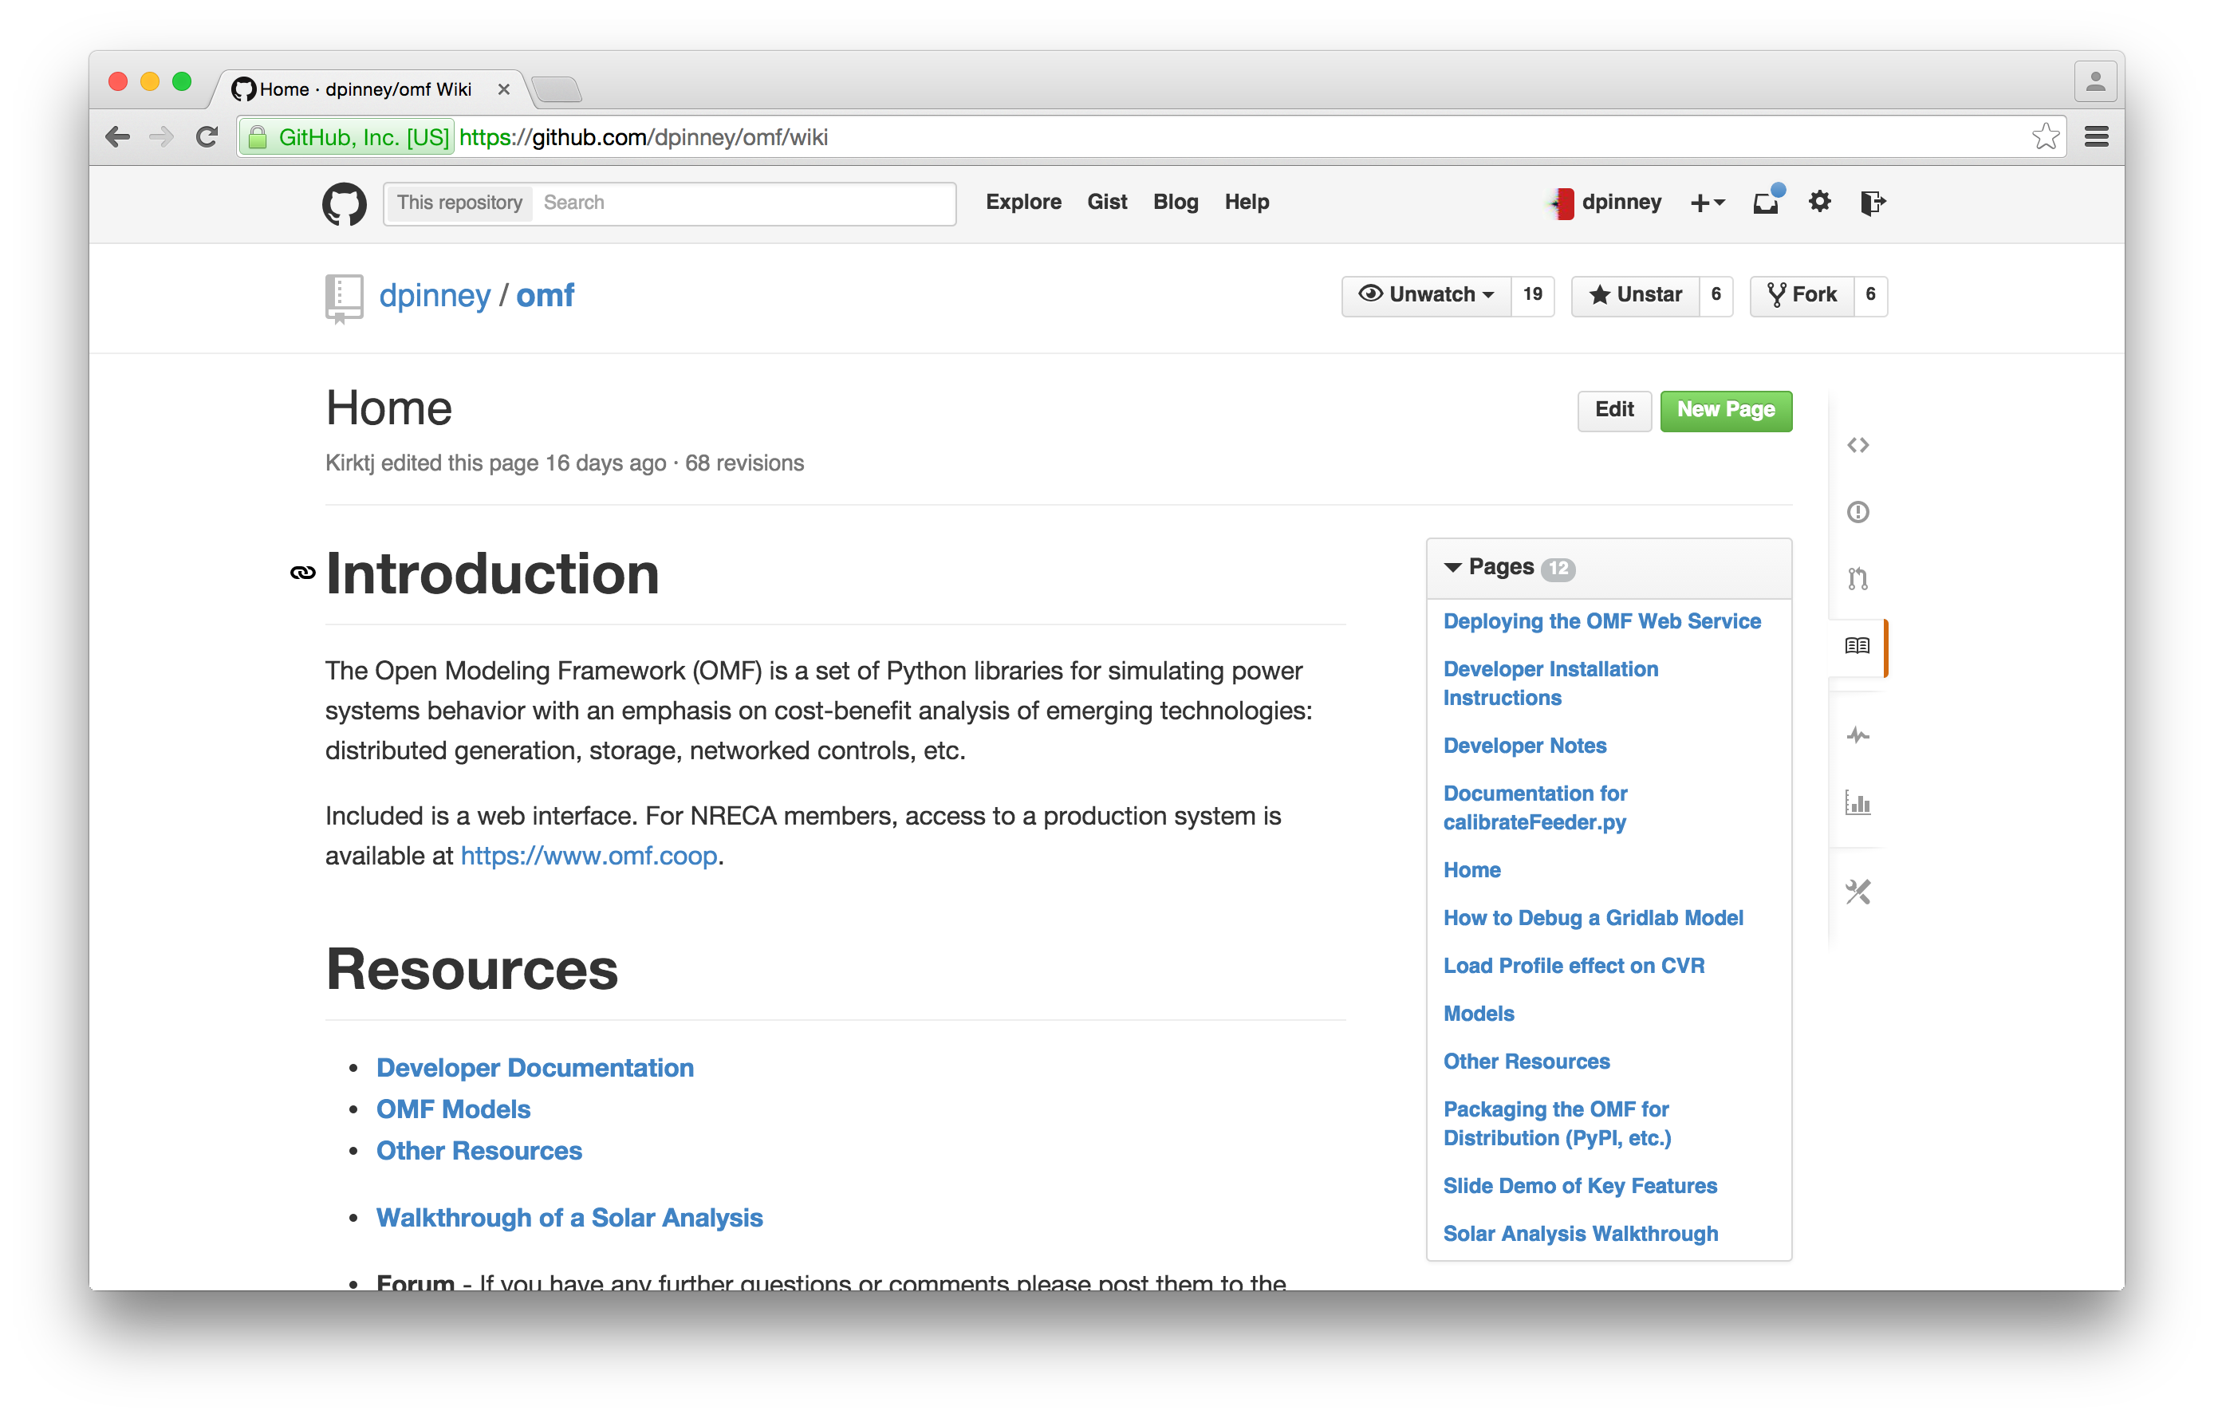
There’s documentation and tutorials.

Slide 6
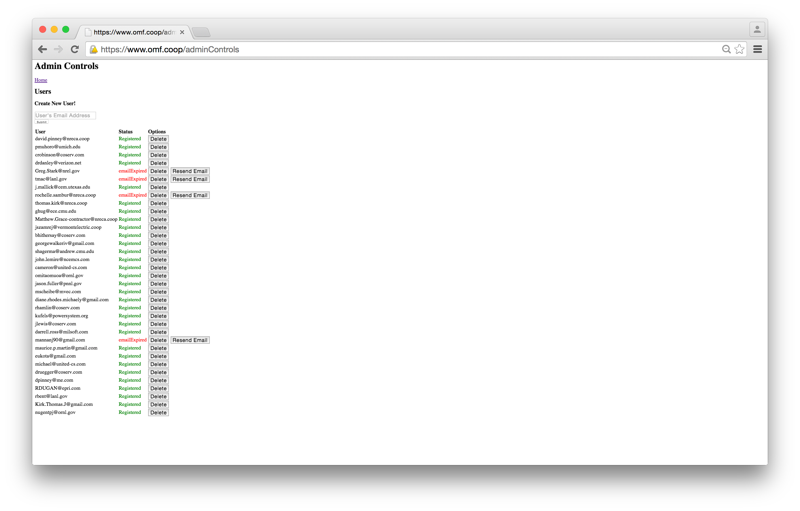
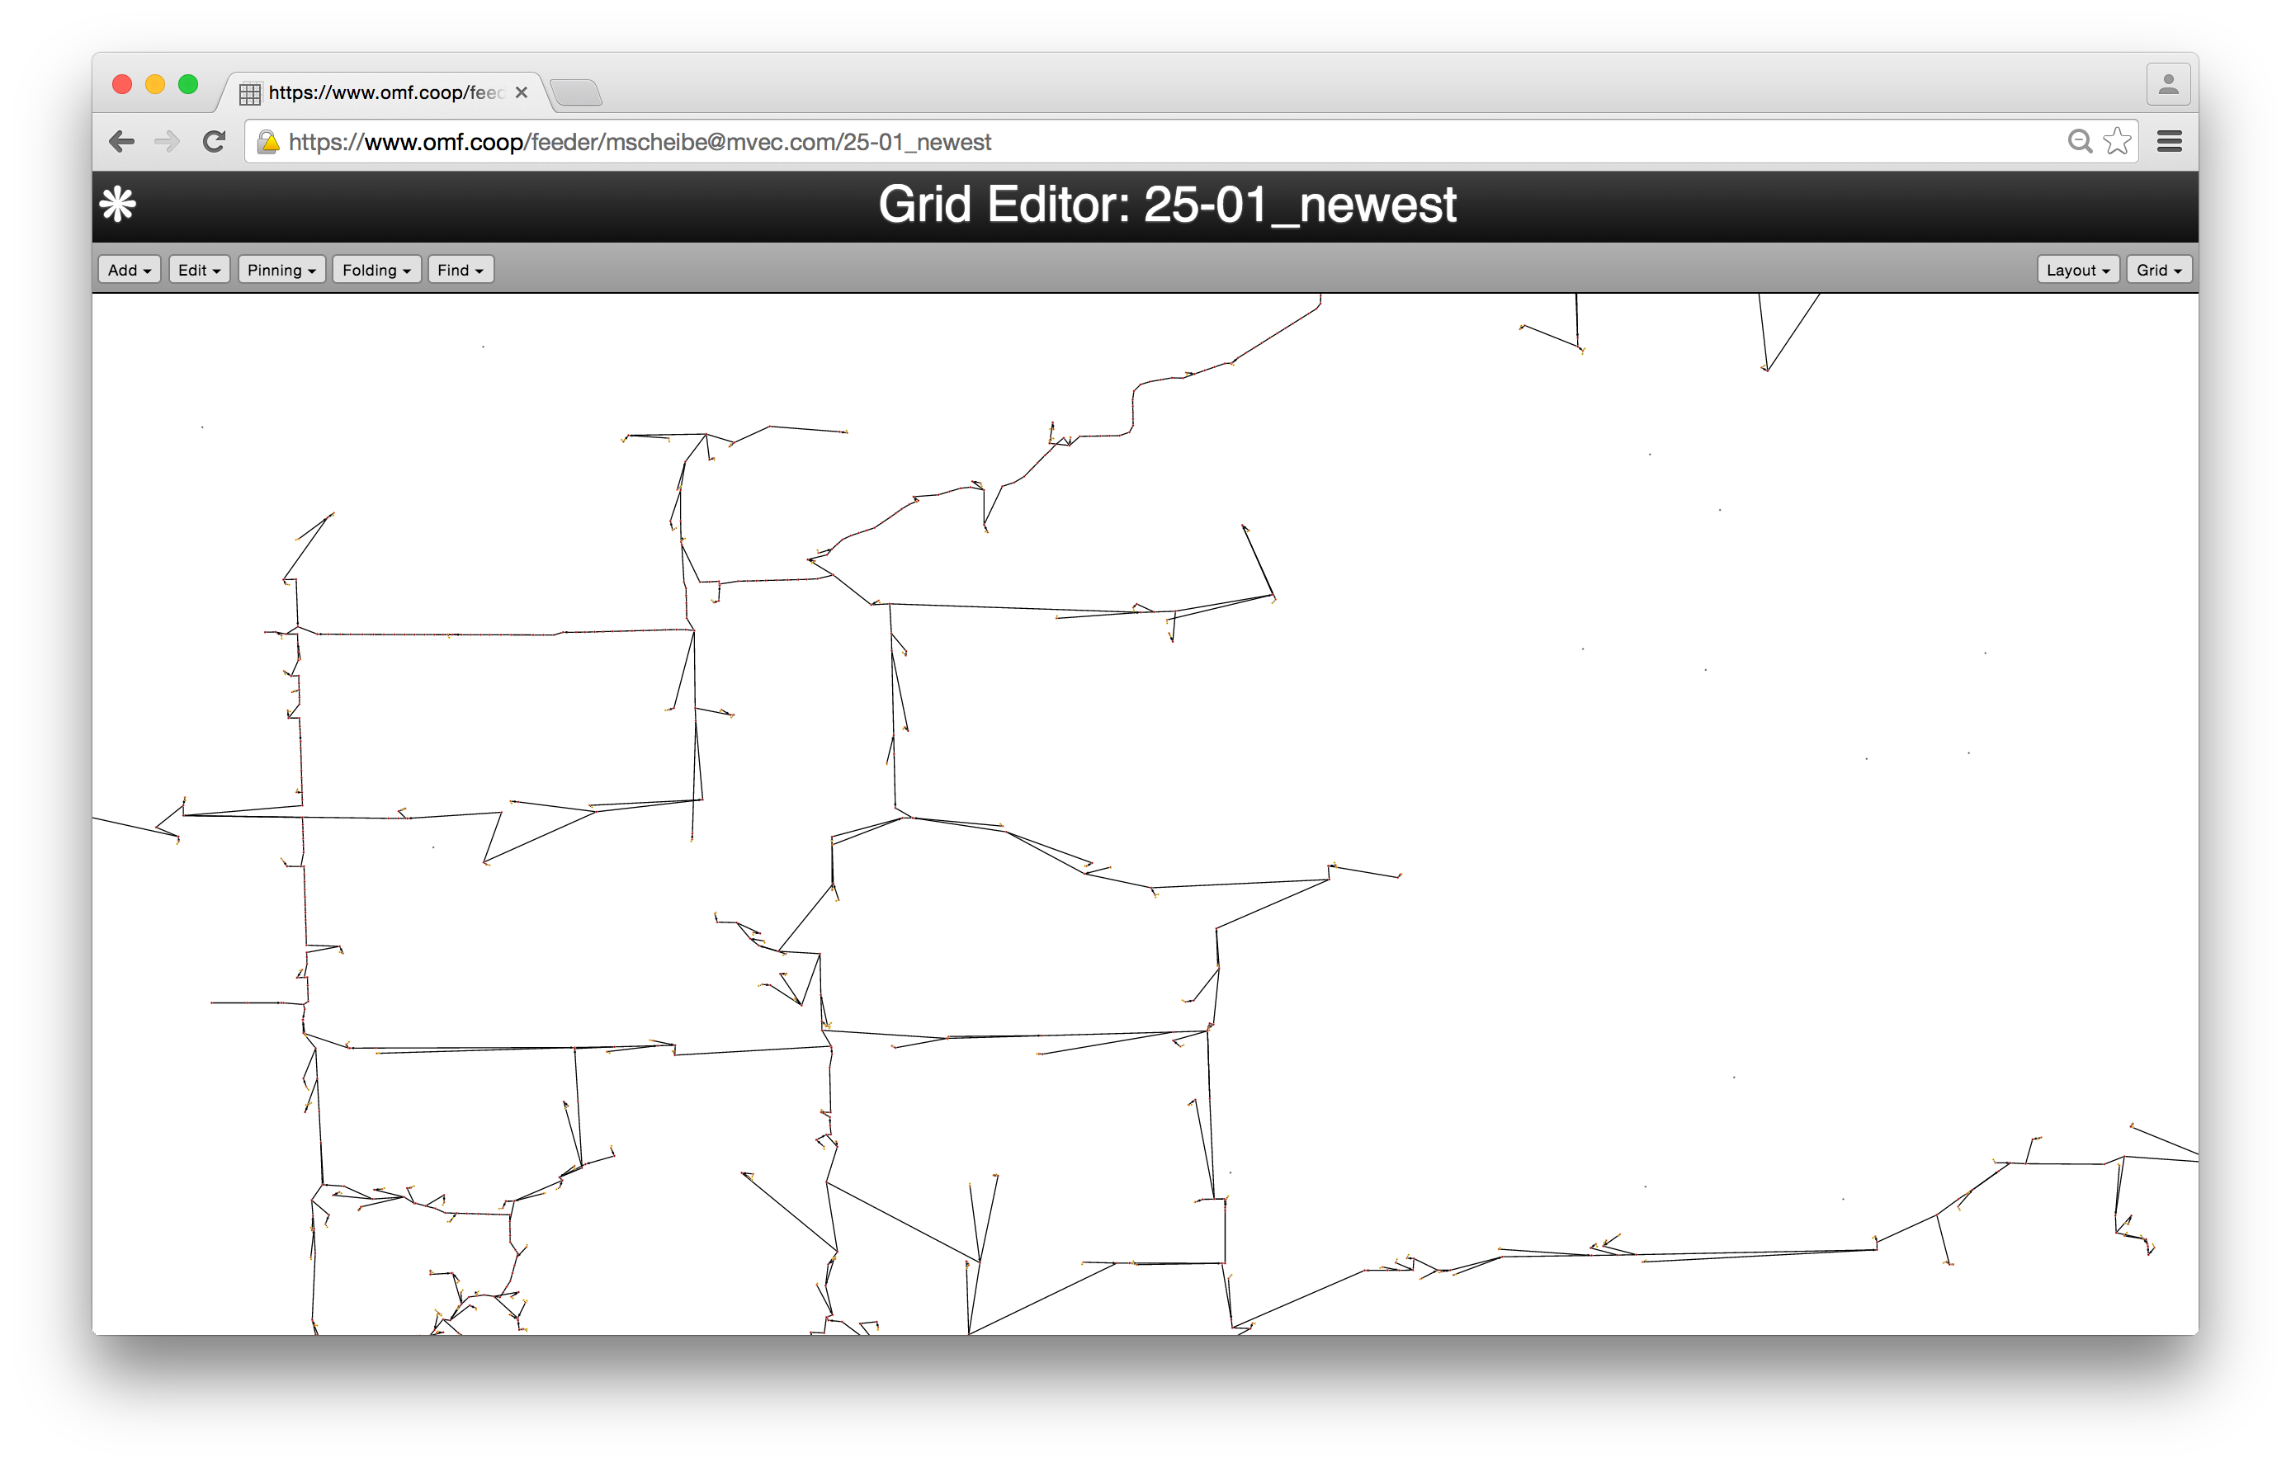
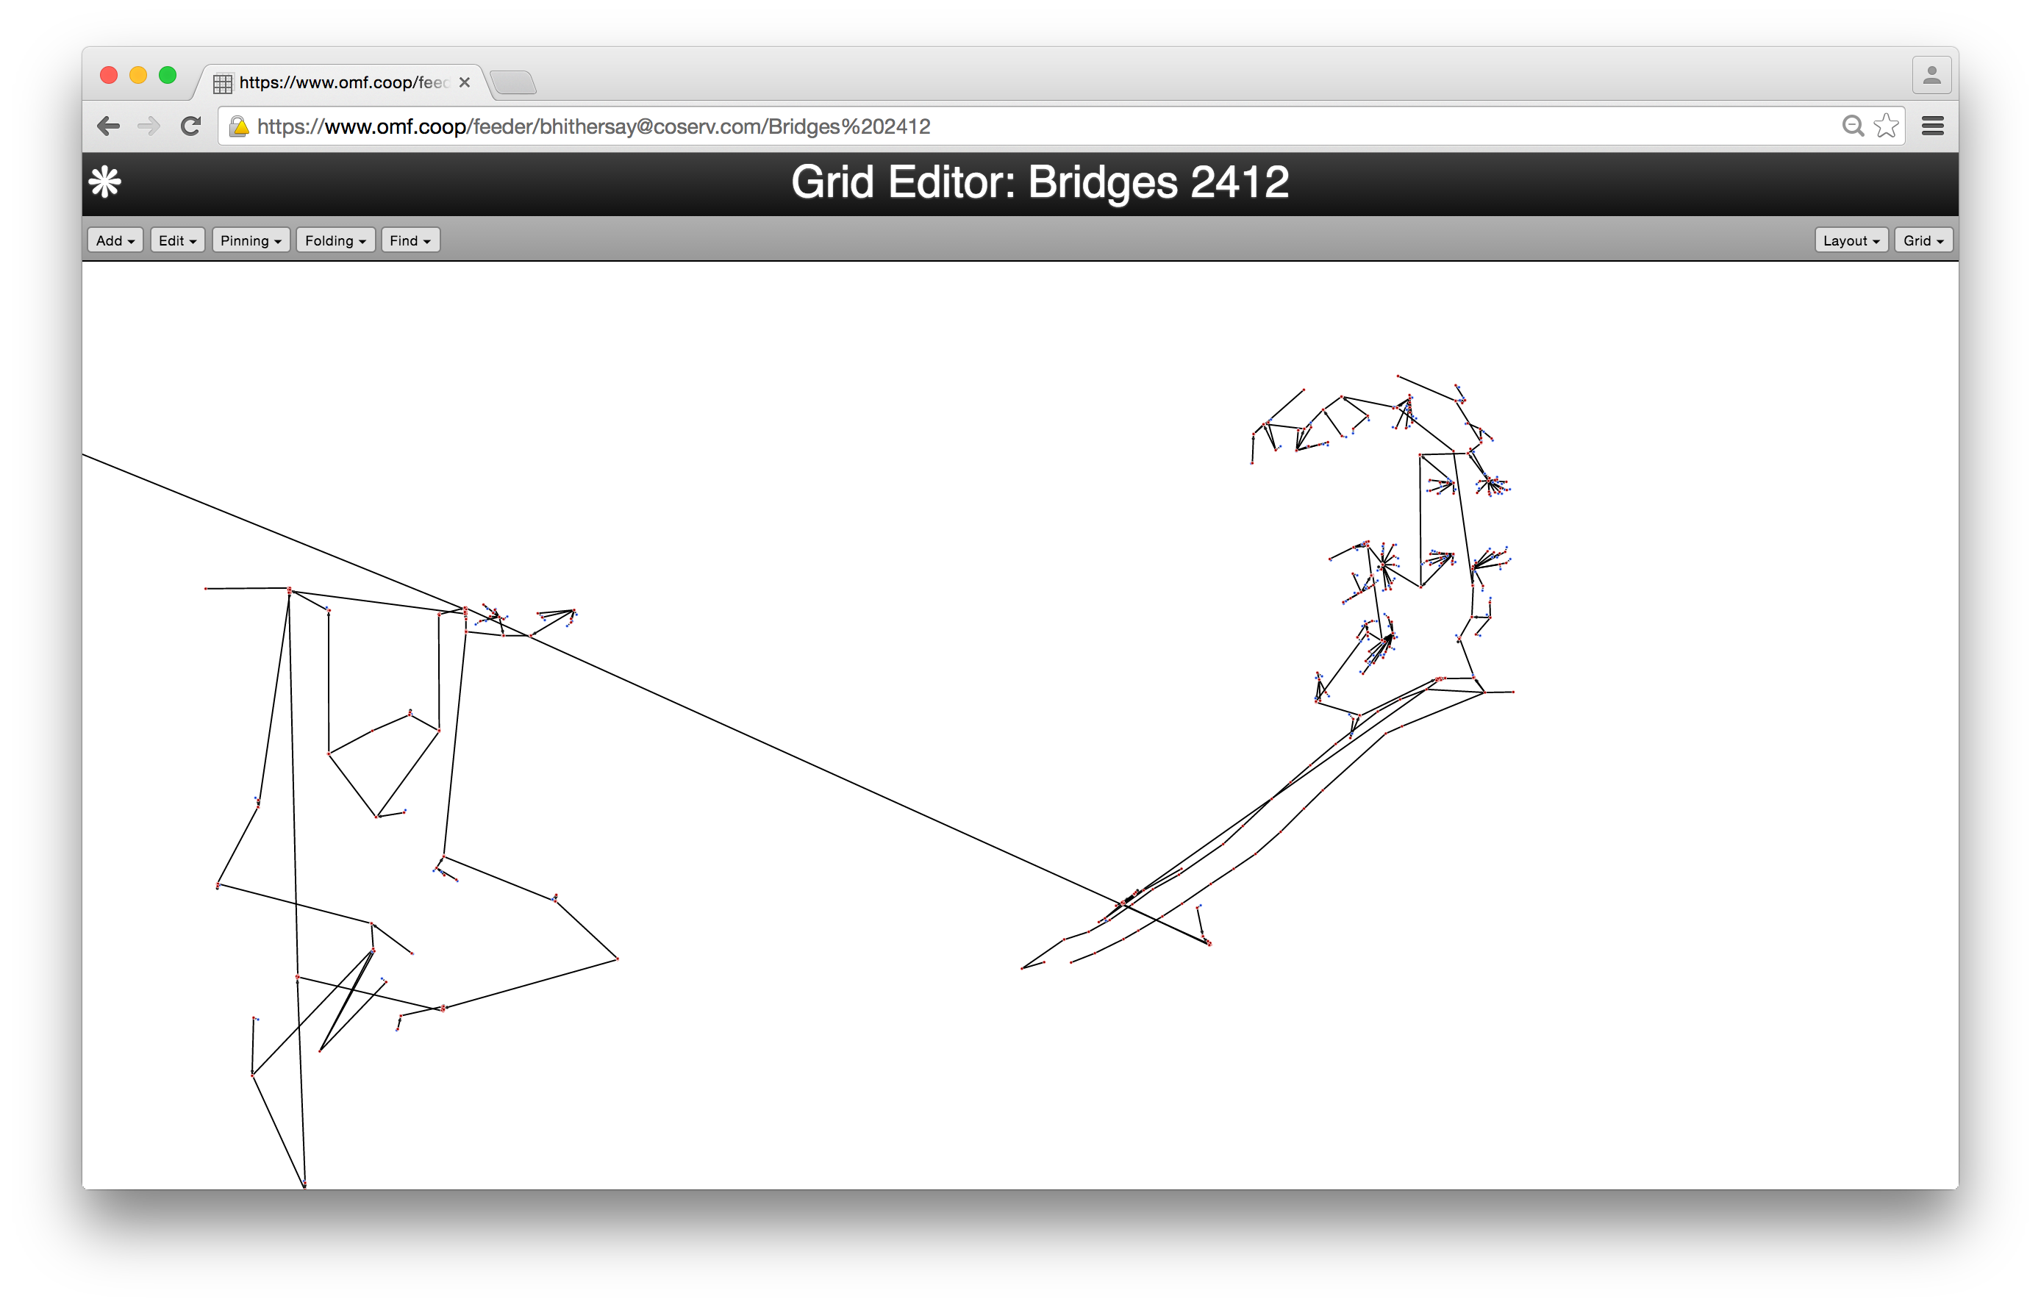
Utilities, vendors and researchers are using it.
Users from 176 different organizations as of 20 June 2017

Slide 7
Why was it built? It was needed for ARRA research.
Notes:
Needed modeling tools for the SGDP to complete the study reporting requirement.
Some tools existed, but no one tool did everything we need to model smart grid technology.
We realized that what we built, with a little generalization, could be useful far beyond the SGDP.

Slide 8
Researchers like our full vision: a framework to support all models.
Model
Model
Model
Model
…
OMF
Notes:
DOE, industry and the research community have hundreds of models.
It’s not clear which are useful because they all have different inputs and outputs.
If all the models are built in a common framework with common inputs and outputs, they can be compared.
Also, gathering good clean data is about 90% of any modeling effort. So the framework can speed up modeling.

Slide 9
We get good press.
“Please find attached a pre-print and a citation for the paper I wrote that cites your housing script.” — Tim Hansen, NREL
“OMF seems to be a perfect match to demonstrate the smart grid concept especially for power system behaviors in visualized ways.” — Andrew Kuo, NIST
“You have done a tremendous amount of important work” — Co-founder, Xendee
“[GridLAB-D] has always been of limited use to utility users due the complexity of building a simulation model, validating results against field data, and presenting the information effectively and easily. The OMF addresses many of these issues, providing a more productive workflow for utility user. — PNNL brochure.

Slide 10
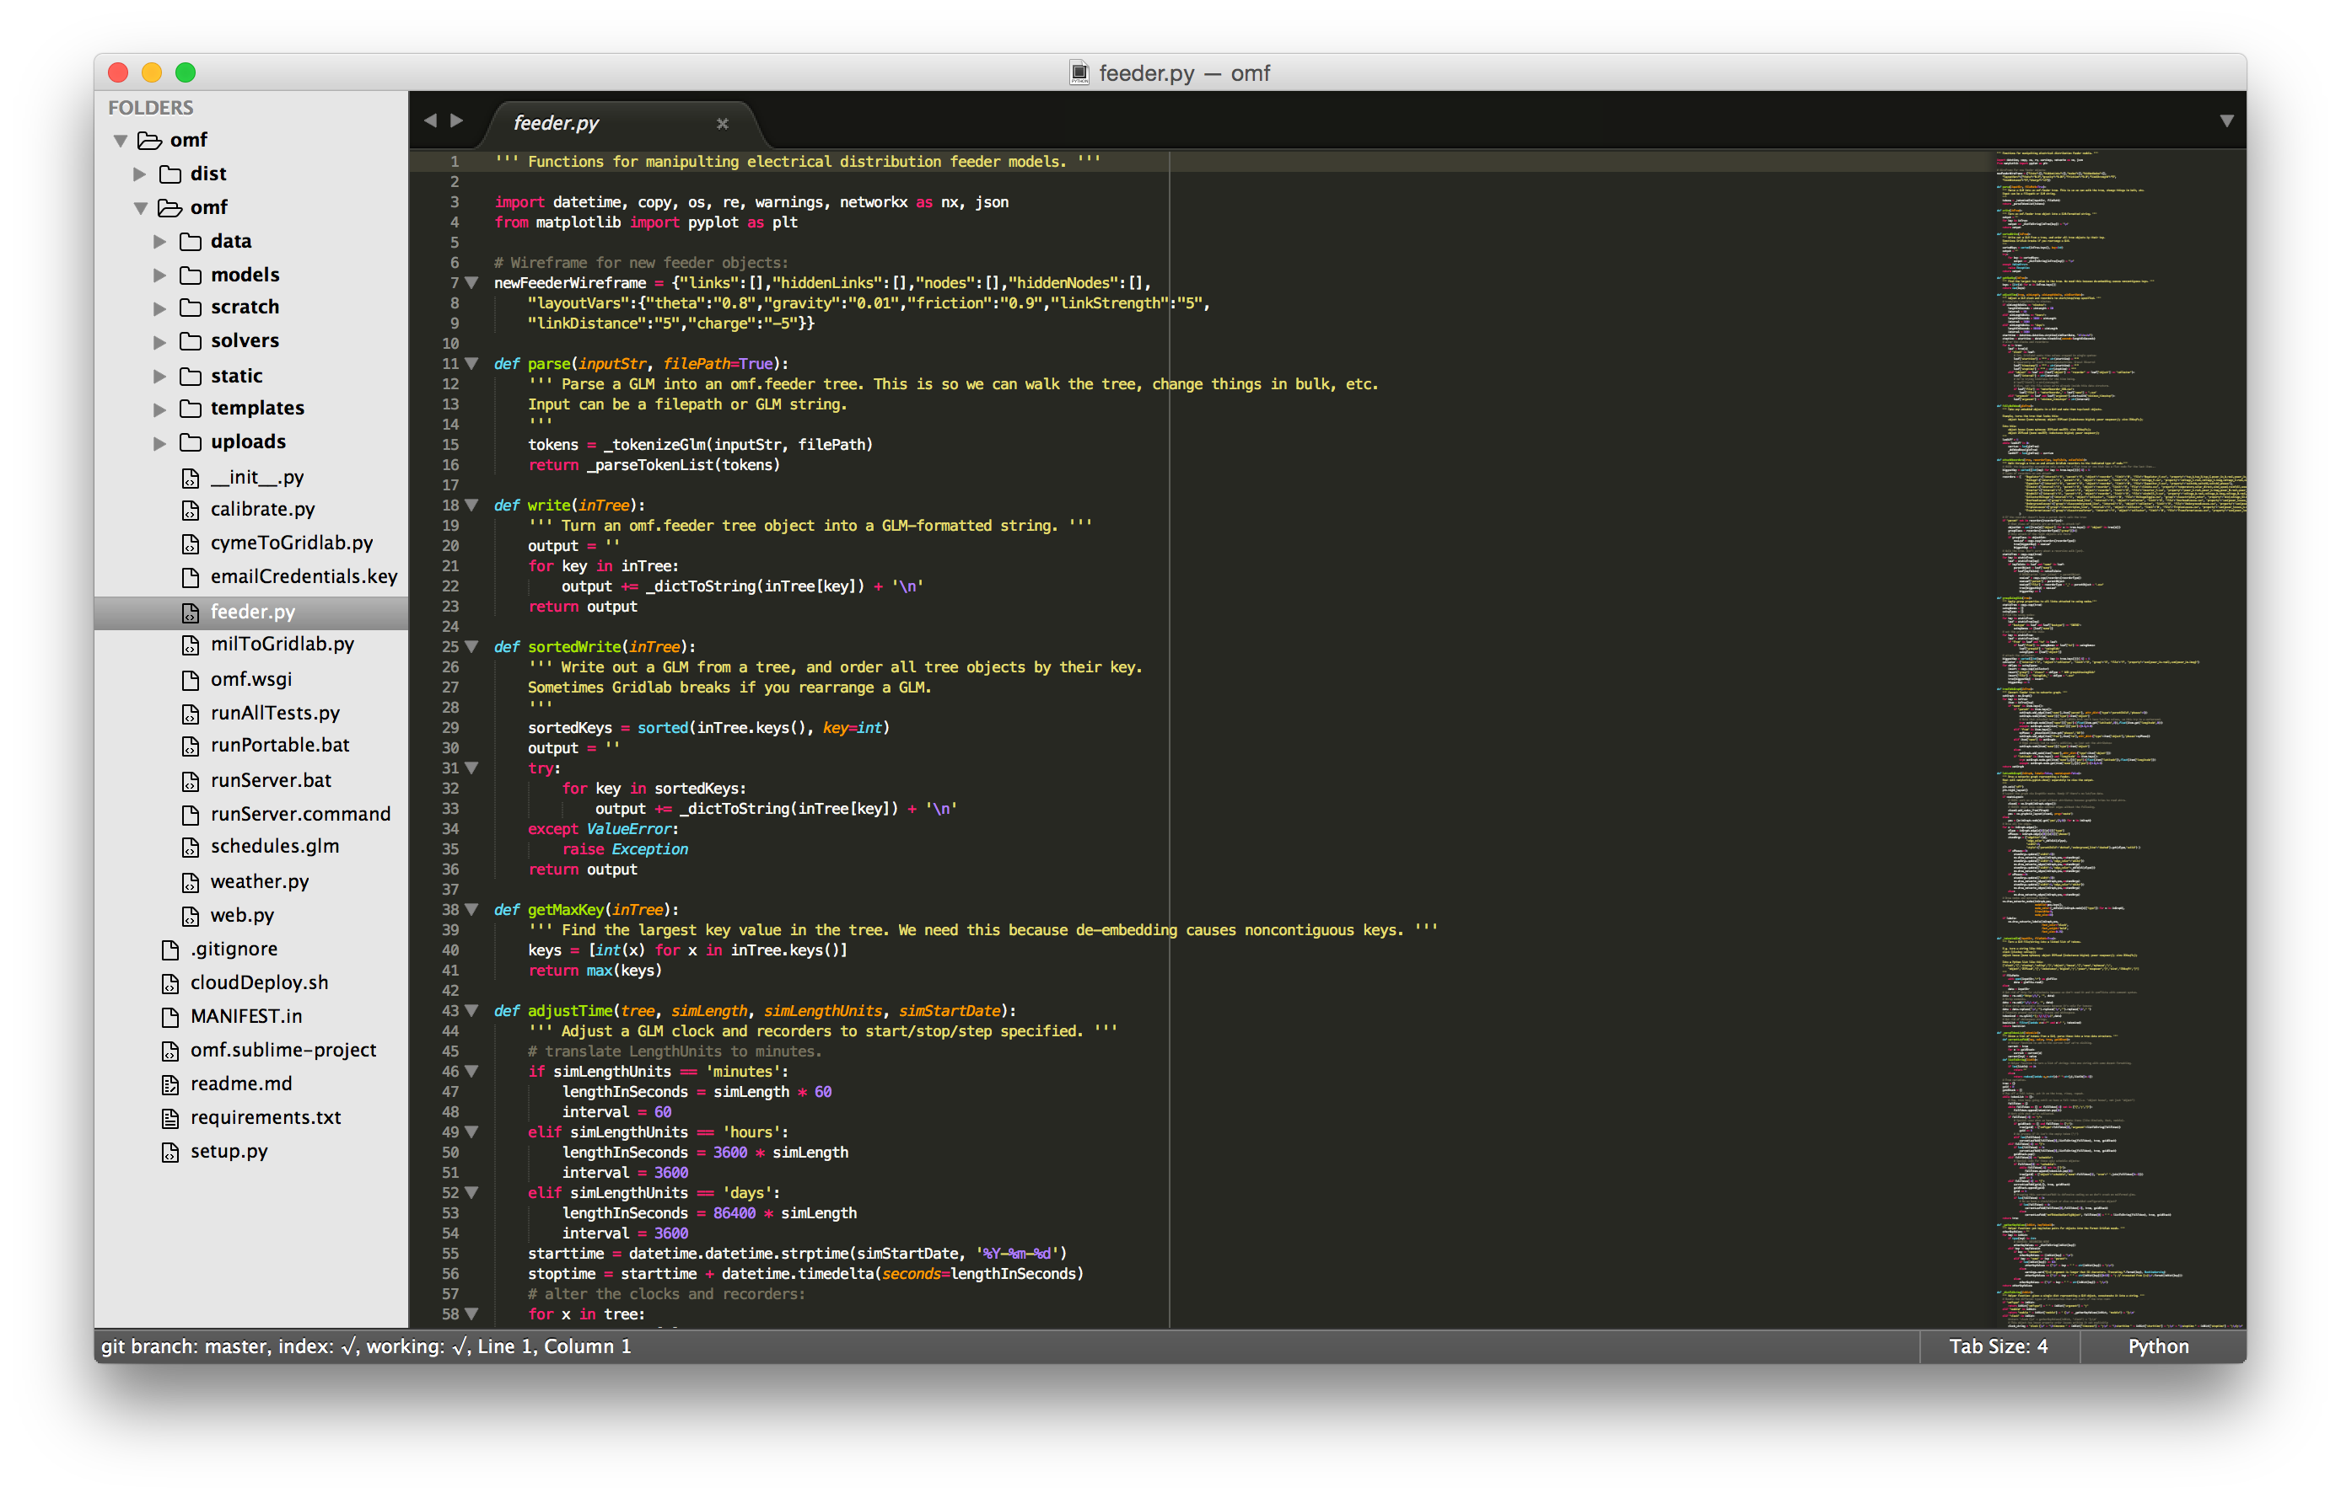
The OMF is an Open Source Project – Others Contribute.

Slide 11
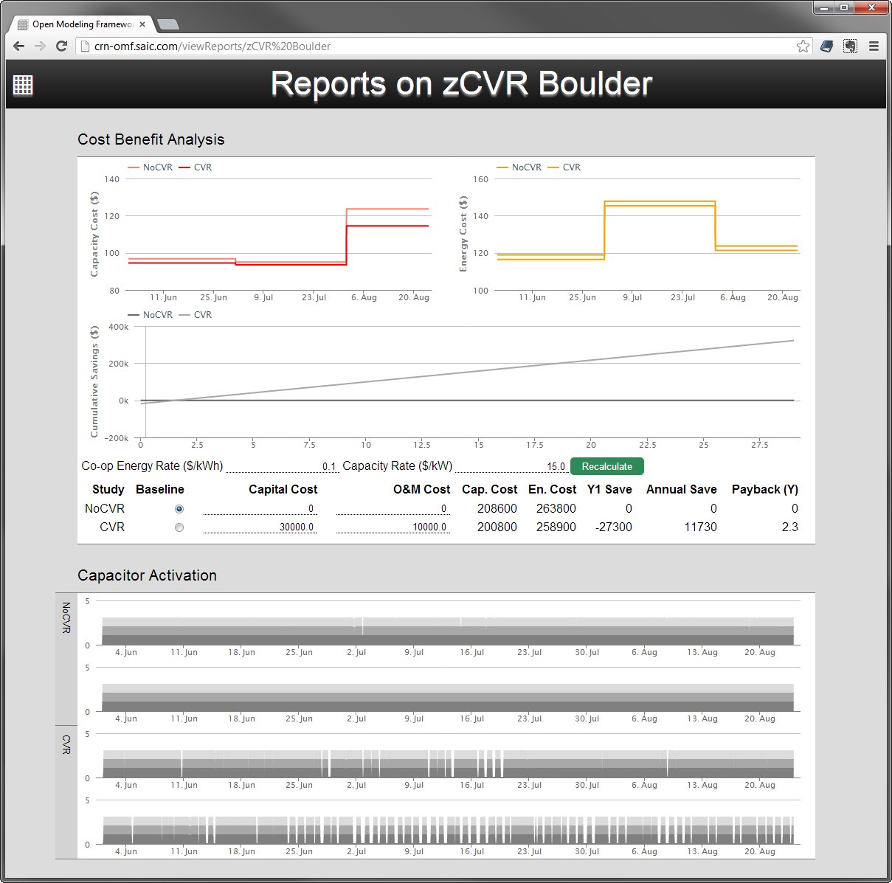
OMF — CVR Peak Demand Reduction
1. Conservation Voltage Reduction (CVR) control scheme simulated over 3 months.
2. CVR peak power shaving converted to capacity cost savings and total cost impact.
3. Control algorithm comparison.
Notes:
Here is an example of how the OMF can be used to design and evaluate a conservation voltage reduction scheme for peak demand reduction.
A Conservation Voltage Reduction scheme was simulated over 3 months; processing time was approximately 40 minutes.
The impacts of the reduced power consumption during peak load is translated in the reporting layer to cost impacts to capacity and energy costs (red and yellow charts). Total cumulative cost impact of the CVR hardware is calculated over 30 years. Payback period in this case was 2.3 years.
Impact of the CVR scheme on capacitor bank switching behavior displayed here. We can evaluate multiple control schemes (and/or grid products).

Slide 12
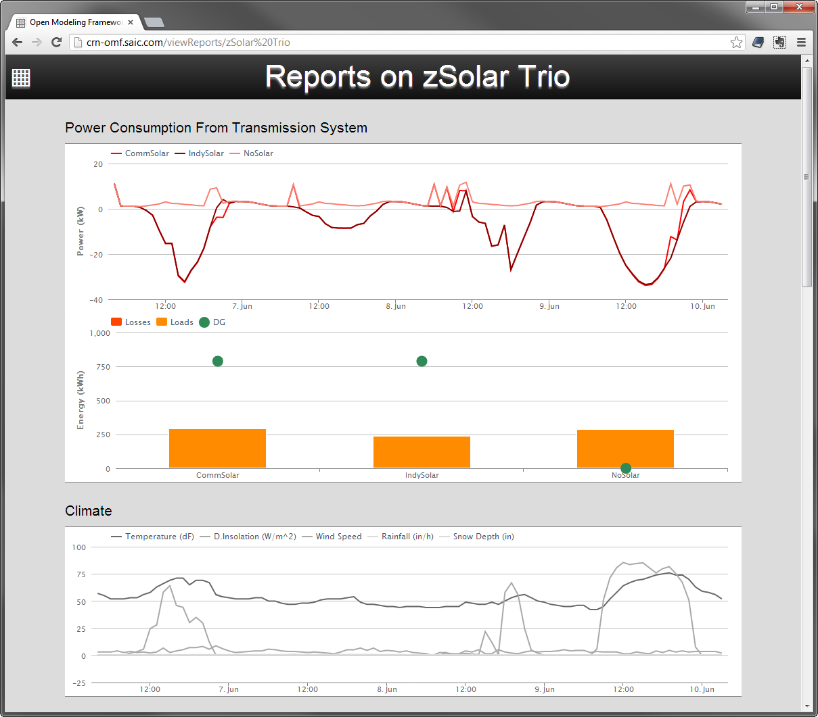
OMF — Reporting Output on Solar Simulation
1: Comparison of 3 systems over 4 days.
2: Reverse powerflow predicted.
3: Full climate simulation.
Notes:
This simulation compares the behavior of three feeders with different levels of solar installed: none, 100% penetration 5kW residential solar, and an equivalent amount of solar installed solar-garden-style directly on the distribution system behind a voltage regulator. Simulation length is 4 realtime days; processing time is about 1 minute.
Simulation predicts cases where excess power is generated by the PV systems and returned to the distribution substation—potential for protective device failure and voltage regulation disruption. Energy calculation shows distributed energy generation is approximately twice load consumption.
Solar generation results are based on a full climate simulation of temperature, direct and indirect insolation, wind speed, etc.

Slide 13
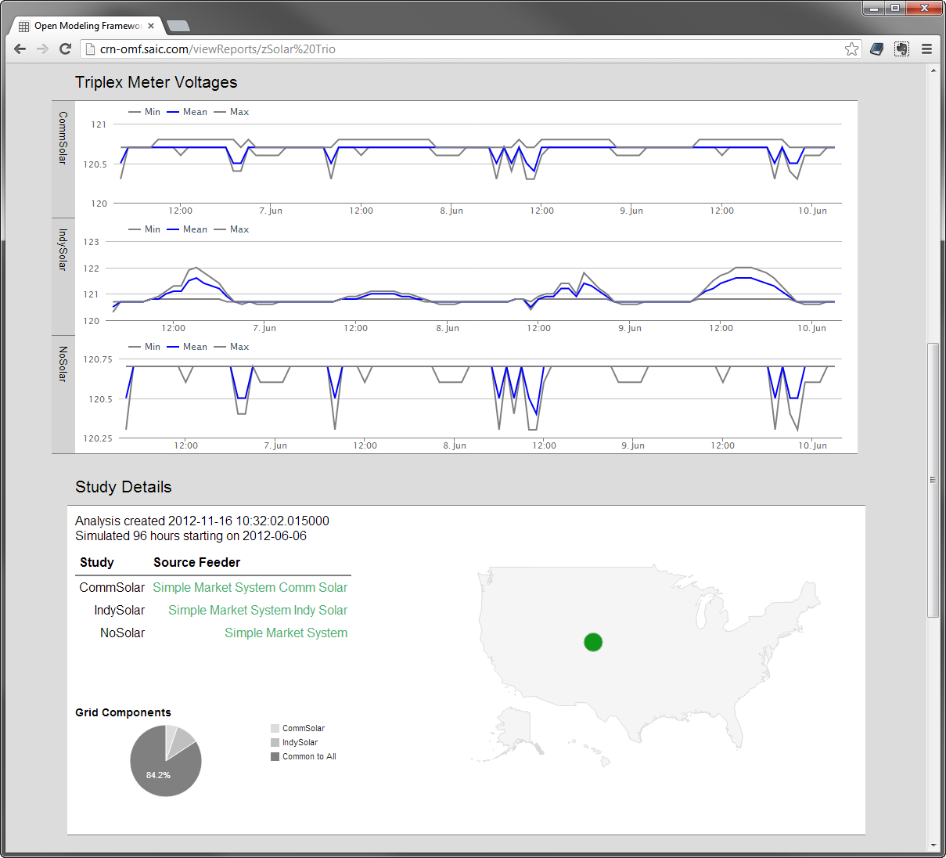
OMF — Solar Simulation Continued
1: Overvoltage predicted in rooftop solar configuration.
Notes:
In the rooftop solar case, overvoltage is predicted during insolation peaks. For the same surface area of PV installed directly to the distribution system behind a voltage regulator, voltage peaks are flattened.

Slide 14









Grid Analytics Association
Notes:
Grid Analytics Association
DoE asked us to incorporate this non-profit organization. It is intended to own, and decide on the development direction for, GridLAB-D, DoE’s most advanced grid simulation software (10 years, about a dozen developers). Craig Miller, our chief scientist, is the president of this association.

